Slide 1
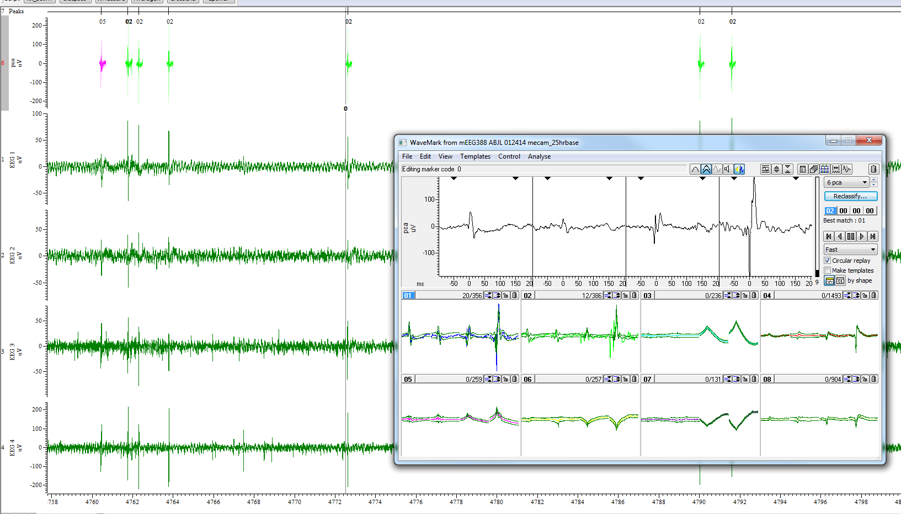
Spike sorting in Spike2 Korey Kam 6/7/2016

Slide 2
Overview
Definition of a spike
Artifacts in freely behaving mice
Detection
Processing events
Export to MATLAB
Processing events with drug injections

Slide 3
Definition of a spike
Cross channel (>2)
Waveform shape
Simple (single positive to negative deflection within 200 ms window)
Complex (multiple positive to negative deflections, within 200 ms window)
Single (generally HC only)

Slide 4
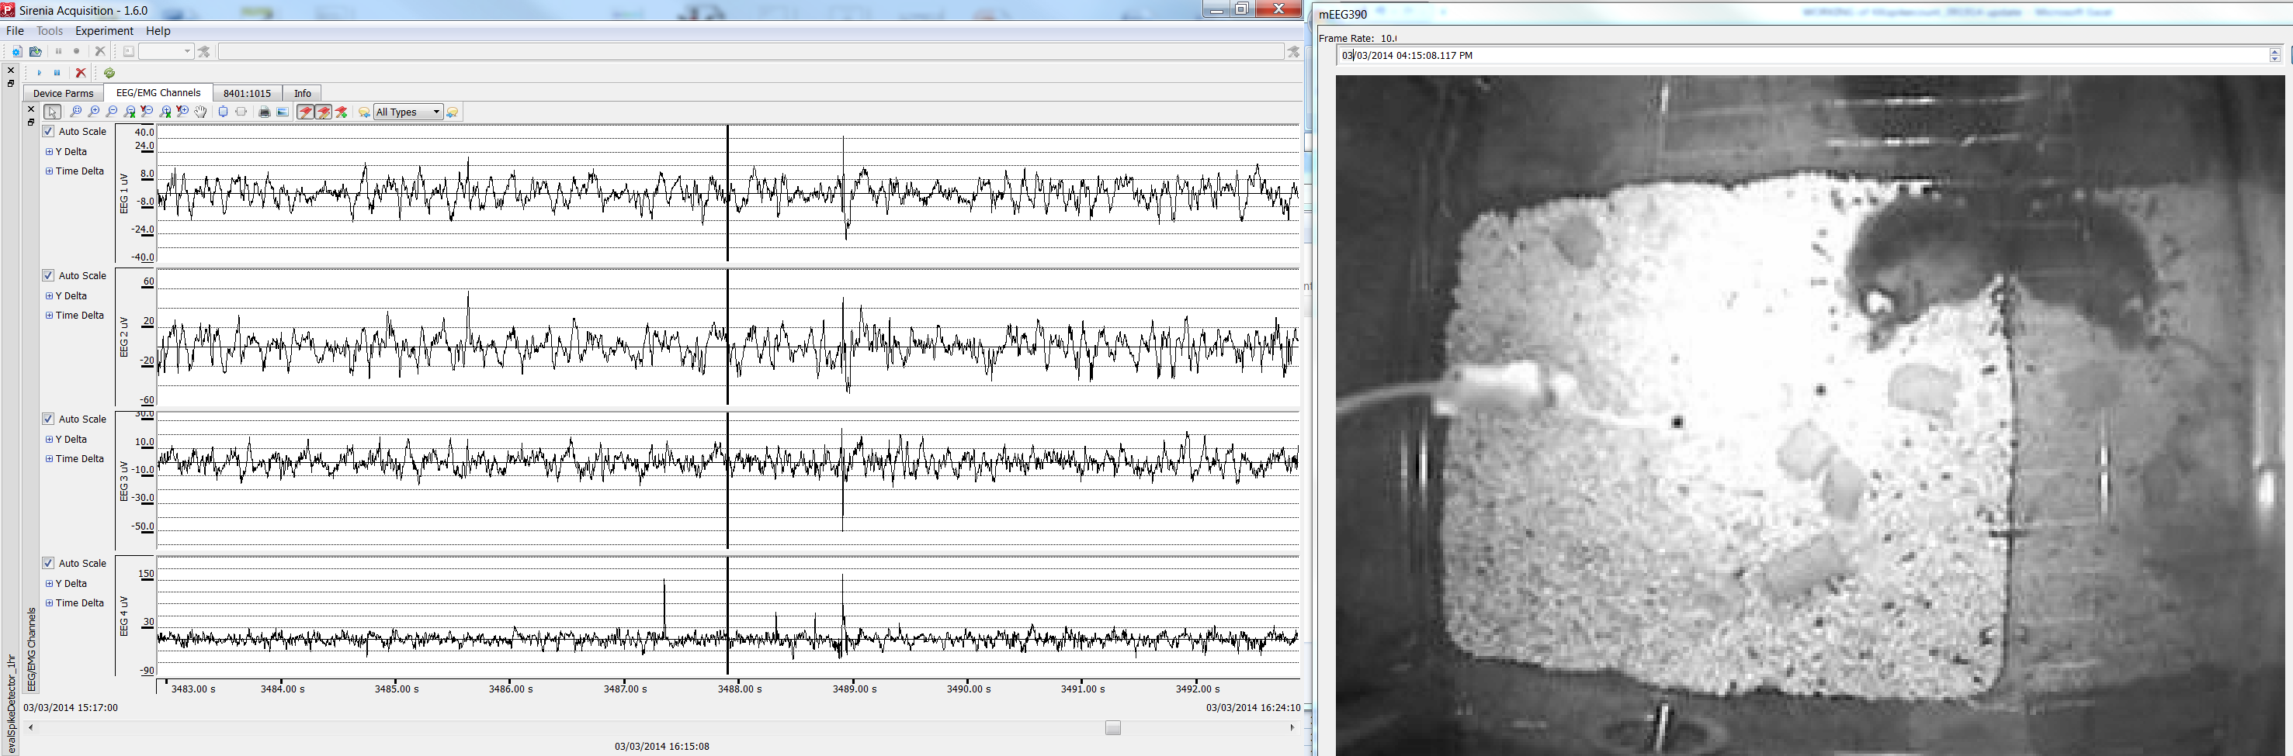
IIS (cross channel, simple)

Slide 5
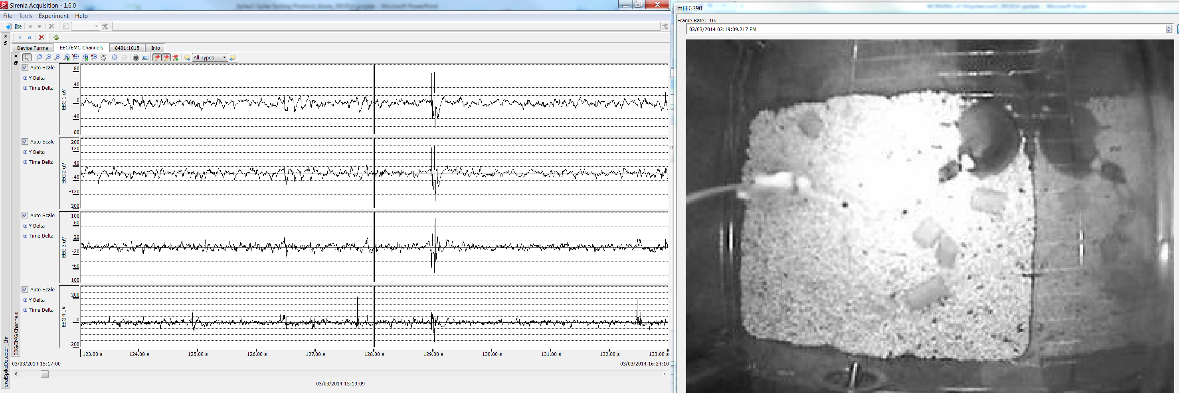
IIS (cross channel, complex)

Slide 6

Focal spikes

Slide 7
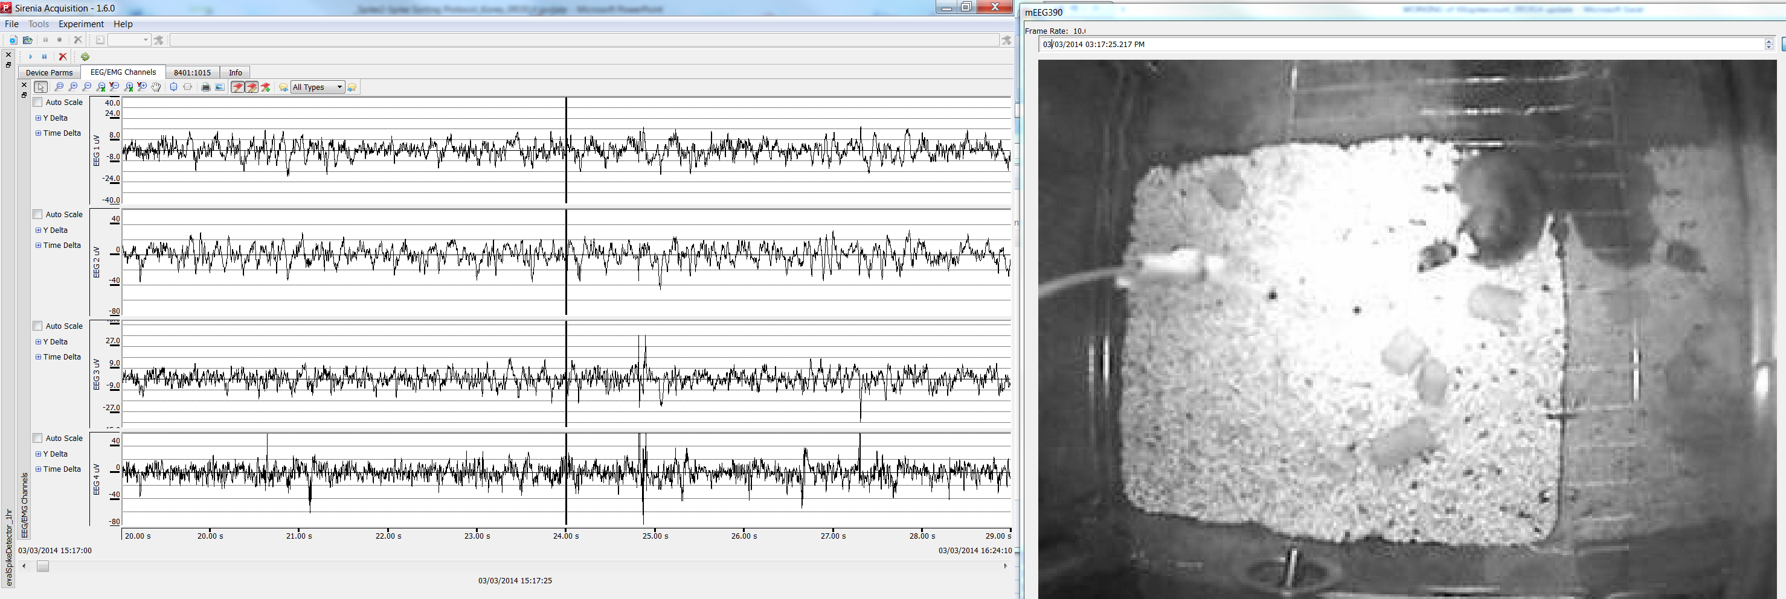
Focal spikes (HC only)

Slide 8
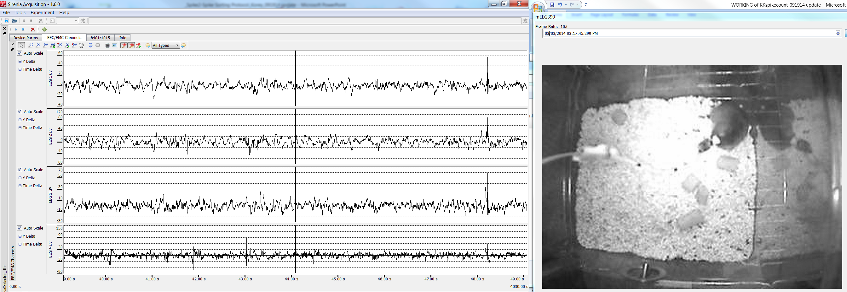
Procedure (manual)
Play realtime
Add marker
Autoscale Y-axis (check button)
10 sec epoch view

Slide 9
ARTIFACTS in freely behaving mice
Jumping
Head scratch
Sleep to wake
Grooming
Chewing
Injection

Slide 10
Types
Jumping
Head scratch
Sleep to wake
Grooming
Chewing
Injection

Slide 11
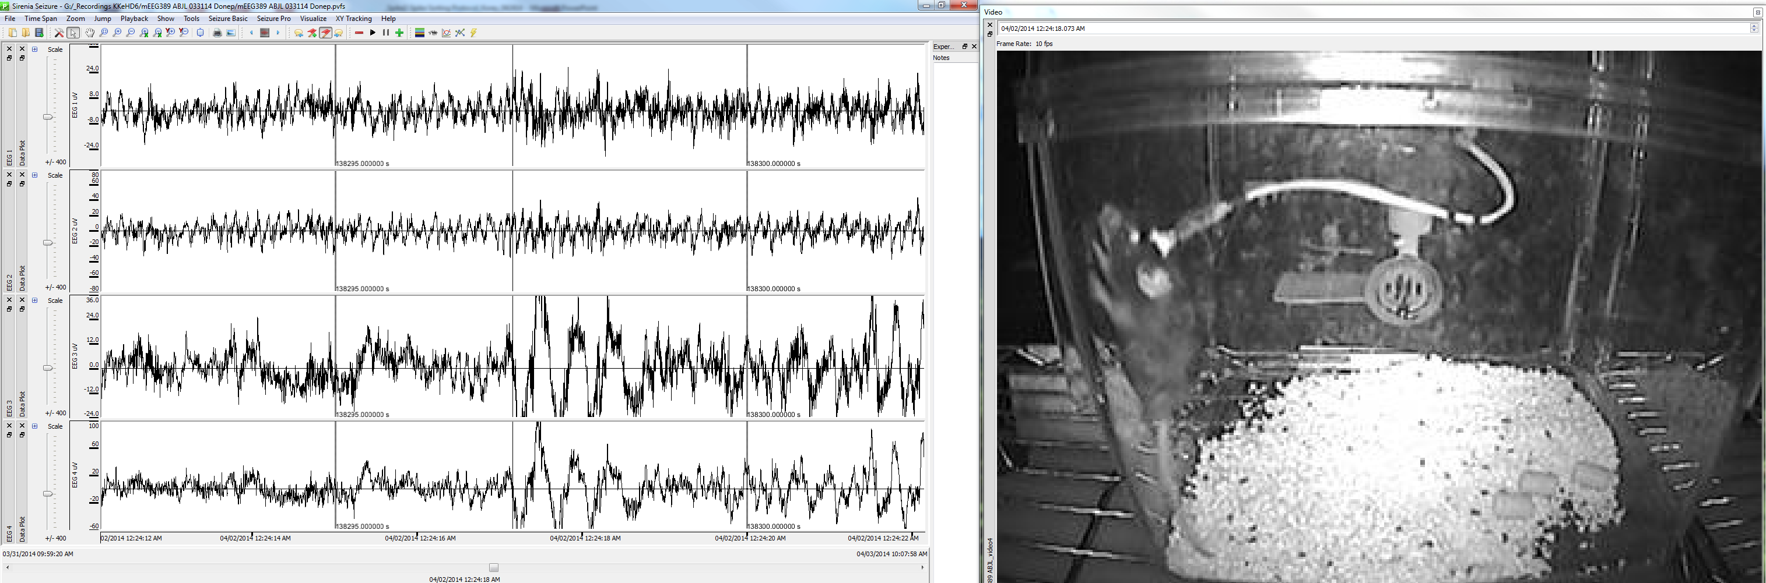
Jumping
Notes:
10 sec

Slide 12
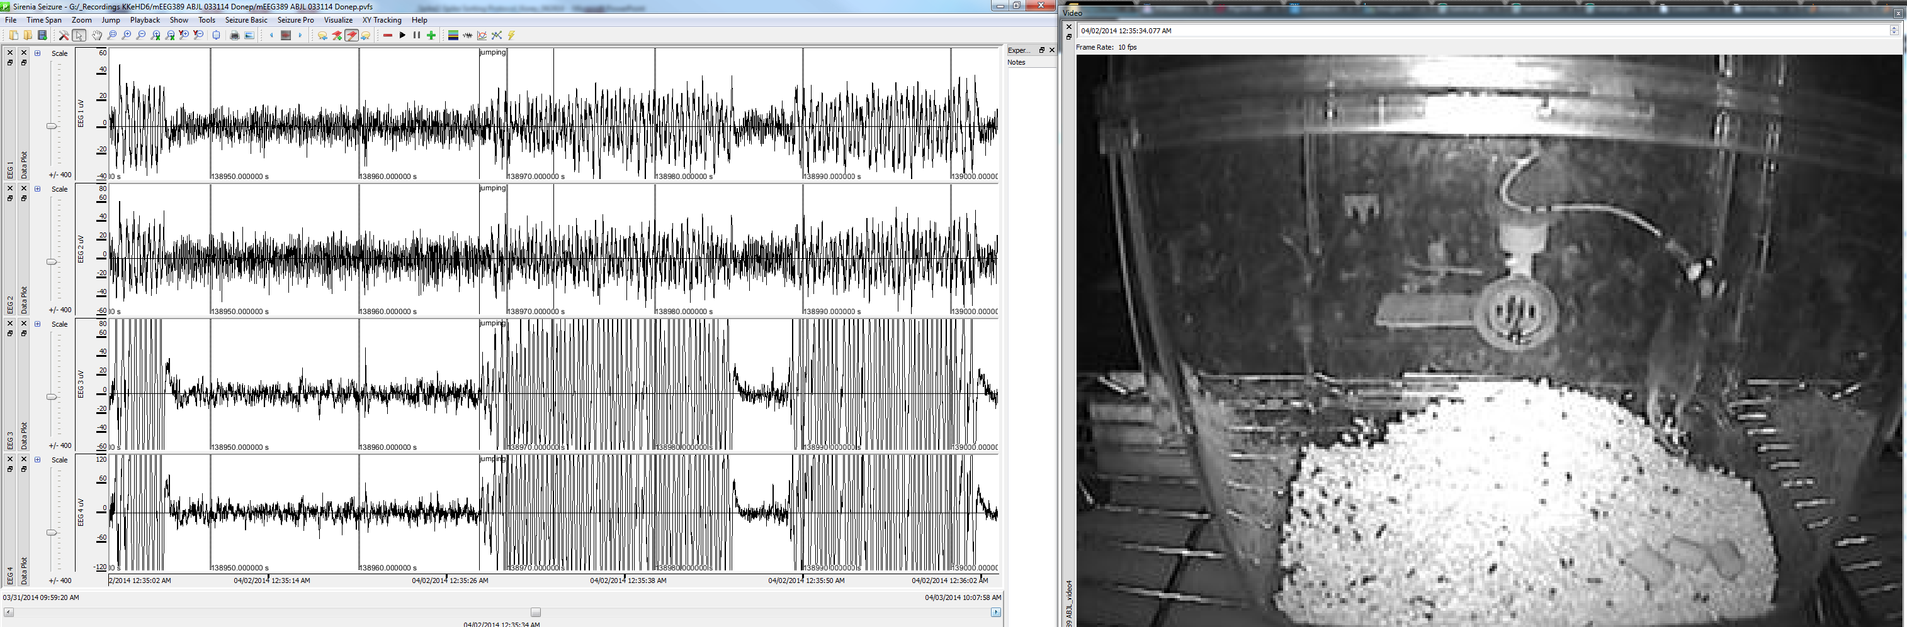
Jumping (1min)

Slide 13
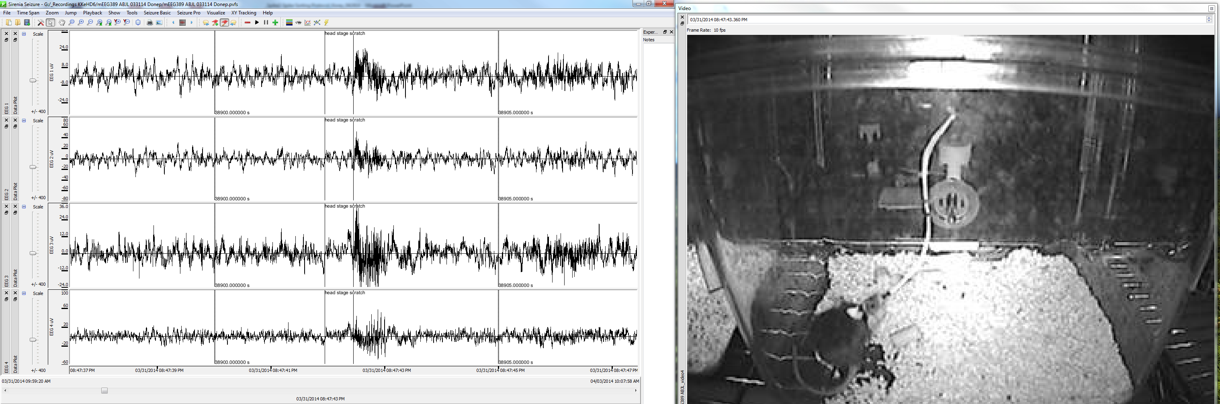
Head stage scratch

Slide 14
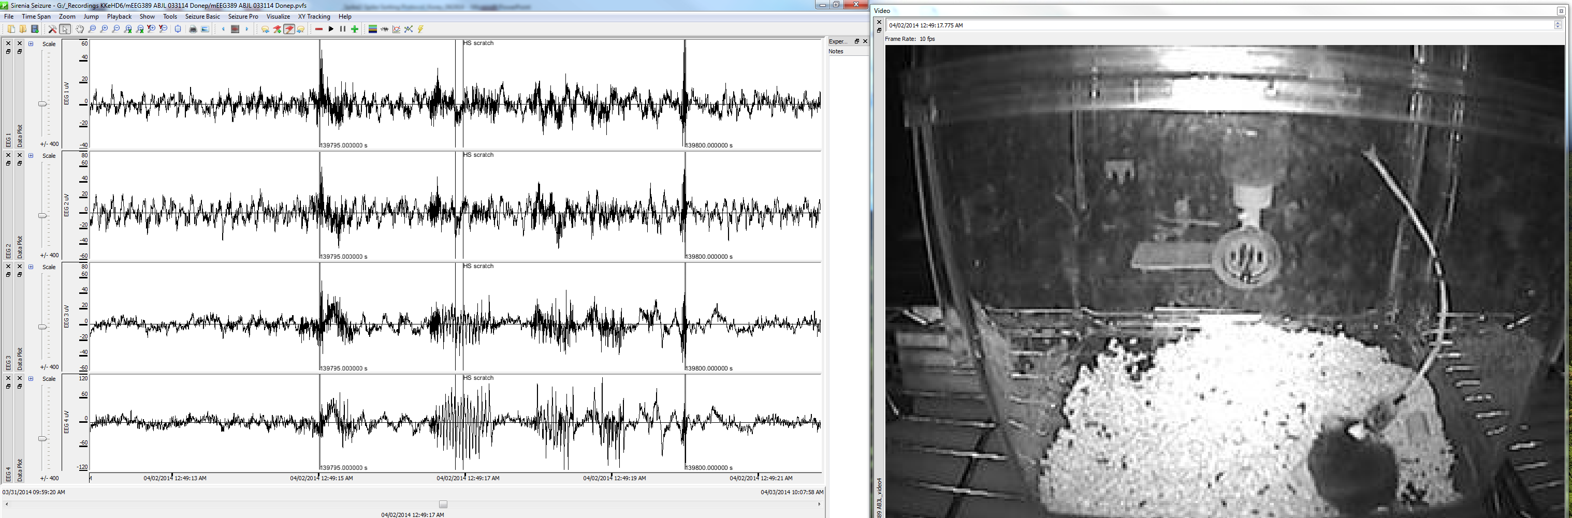
Head stage scratch

Slide 15
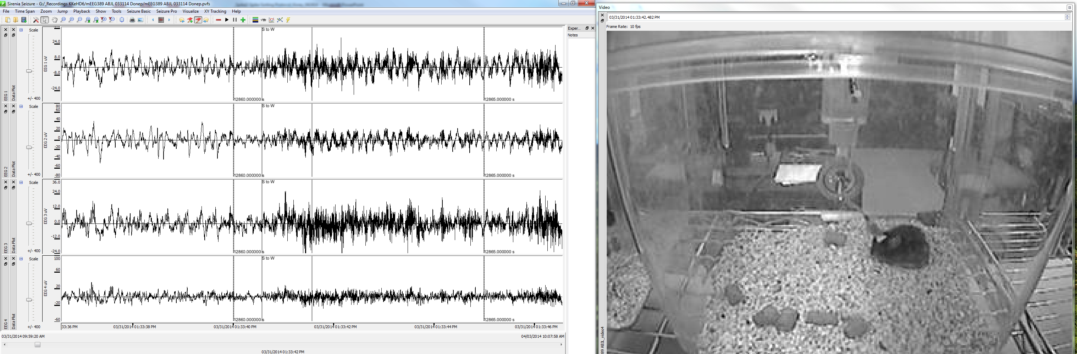
Sleep to Wake

Slide 16
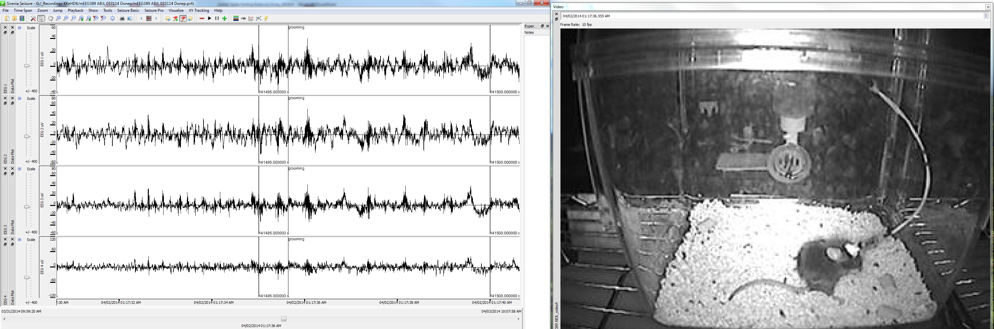
Grooming

Slide 17
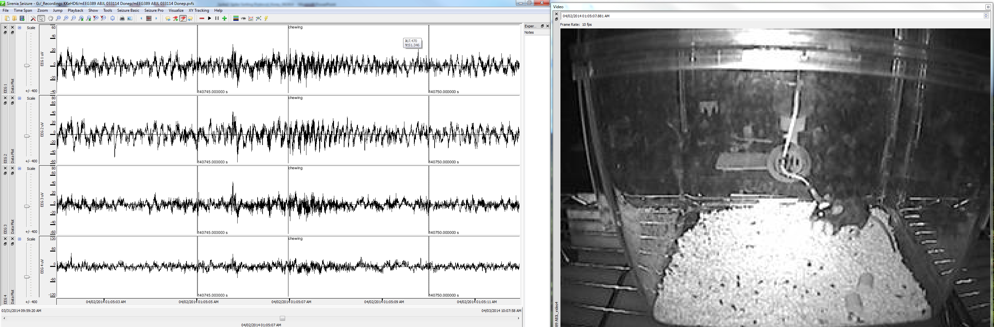
Chewing

Slide 18
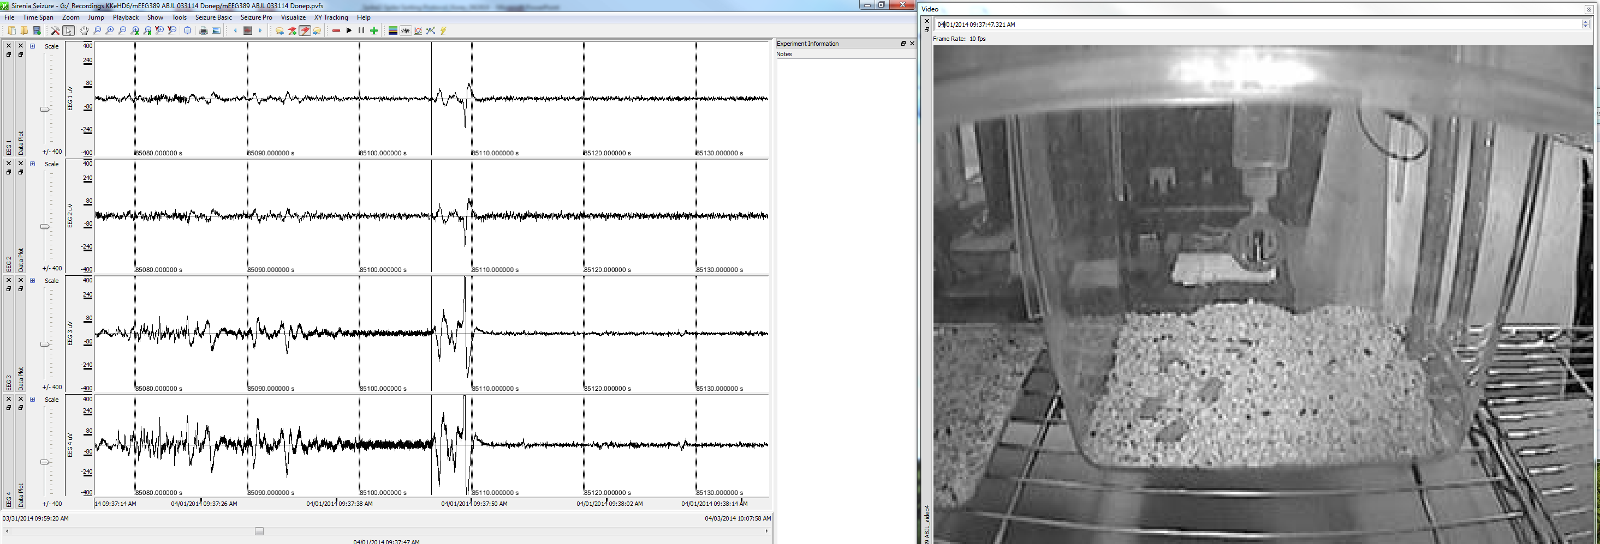
Injection/scruffing

Slide 19
DETECTION

Slide 20
Why use Spike2?
Template vs. threshold only: Spike 2 has built-in powerful methods of spike detection and sorting (spike shape discrimination).
Semi-automated: It took me about 5 min to detect your spikes while rejecting the artifacts using the simplest method: template-based sorting.

Slide 21
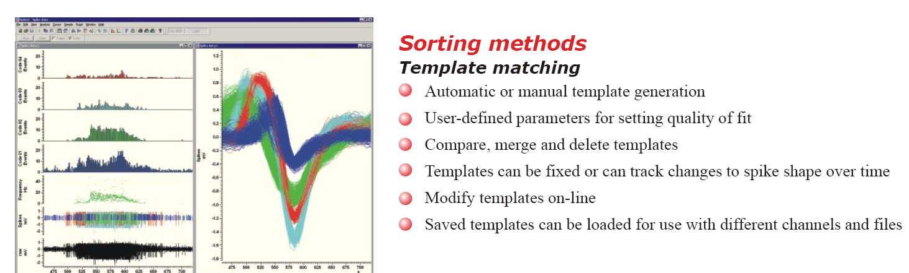
Why look at waveform?
Waveforms can identify a characteristic potential change that may be linked to noise, artifacts, or biologically consistent events.

Slide 22
Spike Detection Overview
Manual detection
Automated detection
Create multichannel event templates (spikes & artifacts)
Search through recording w/ templates
Mark events
PCA → K-means clustering
Quality control
Manual verification
Reclassify events
Re-mark events
Analysis of events
Export to mat
Notes:
Create multichannel event templates (spikes & artifacts)
Search through recording w/ templates
Mark events
PCA → K-means clustering
Quality control
Search marked events with active cursors (manual)
Reclassify events to templates
Re-mark recording
Analysis of events
Waveform analysis
Spike width
PSTHs
Cross correlations
Interval histograms
Rate displays
Mean and instantaneous frequencies
Separate wavemarks: use Average N

Slide 23
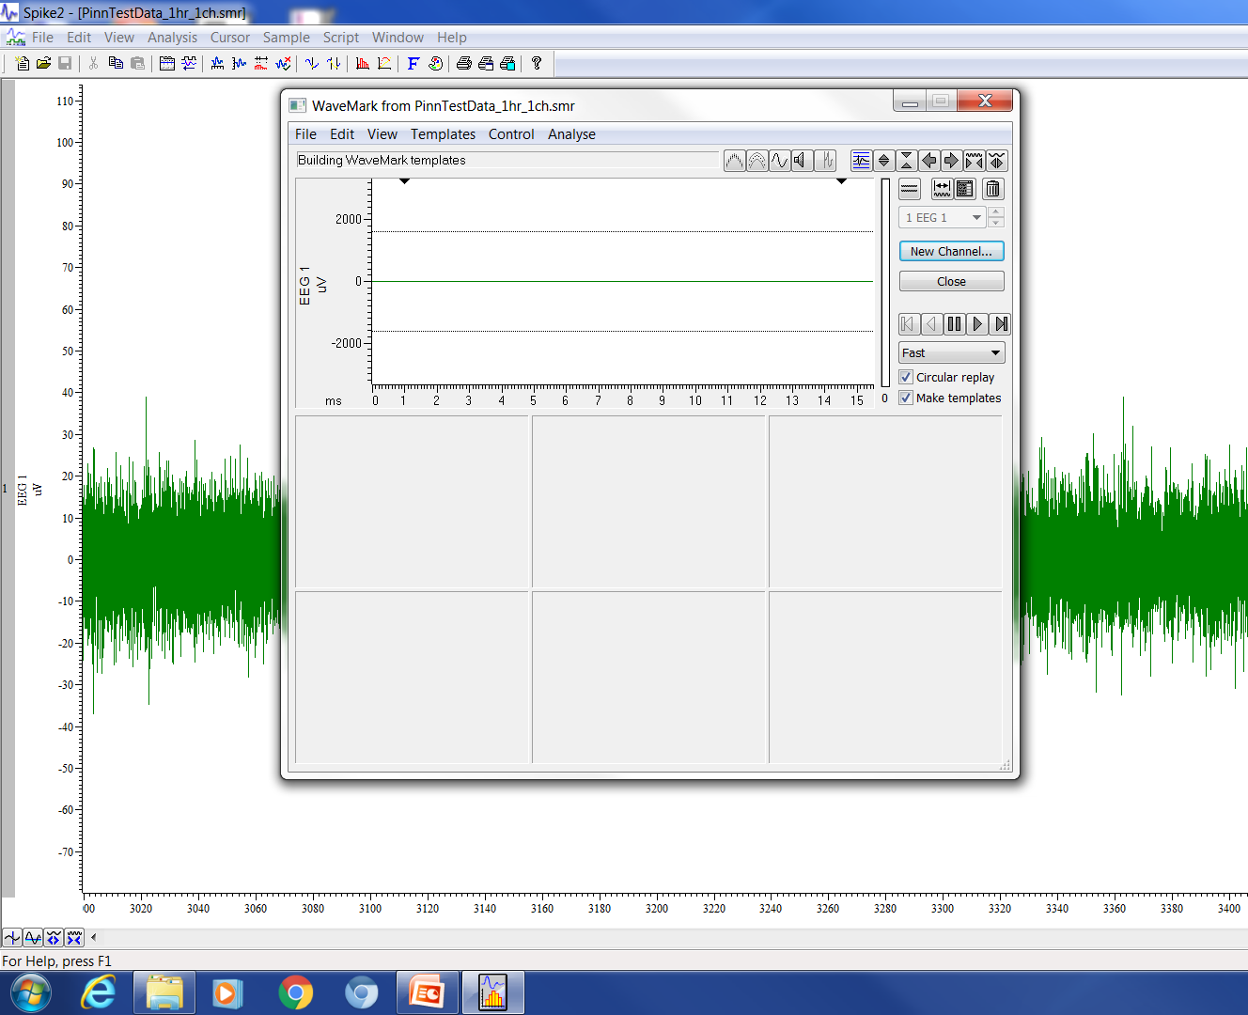
N-trode
Select channels → analysis tab → New N-Trode

Slide 24
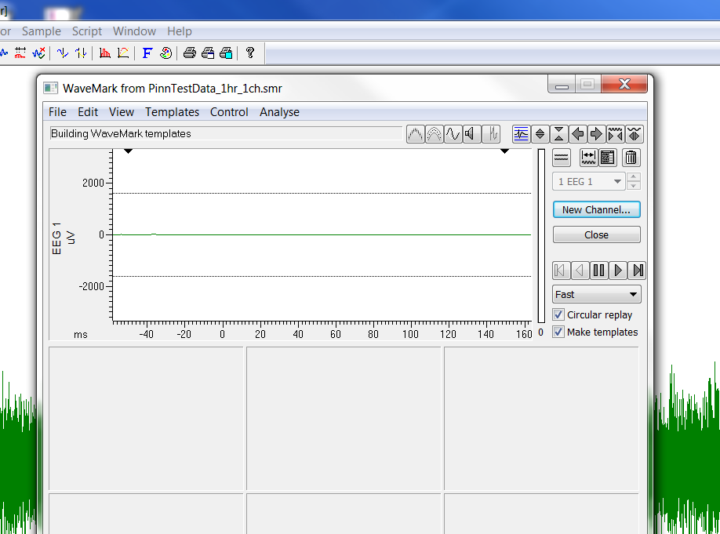
Create window: -50 to 150 ms

Slide 25
Make Templates: Overview
Compute threshold → script
Save measurements
Run event detection

Slide 26
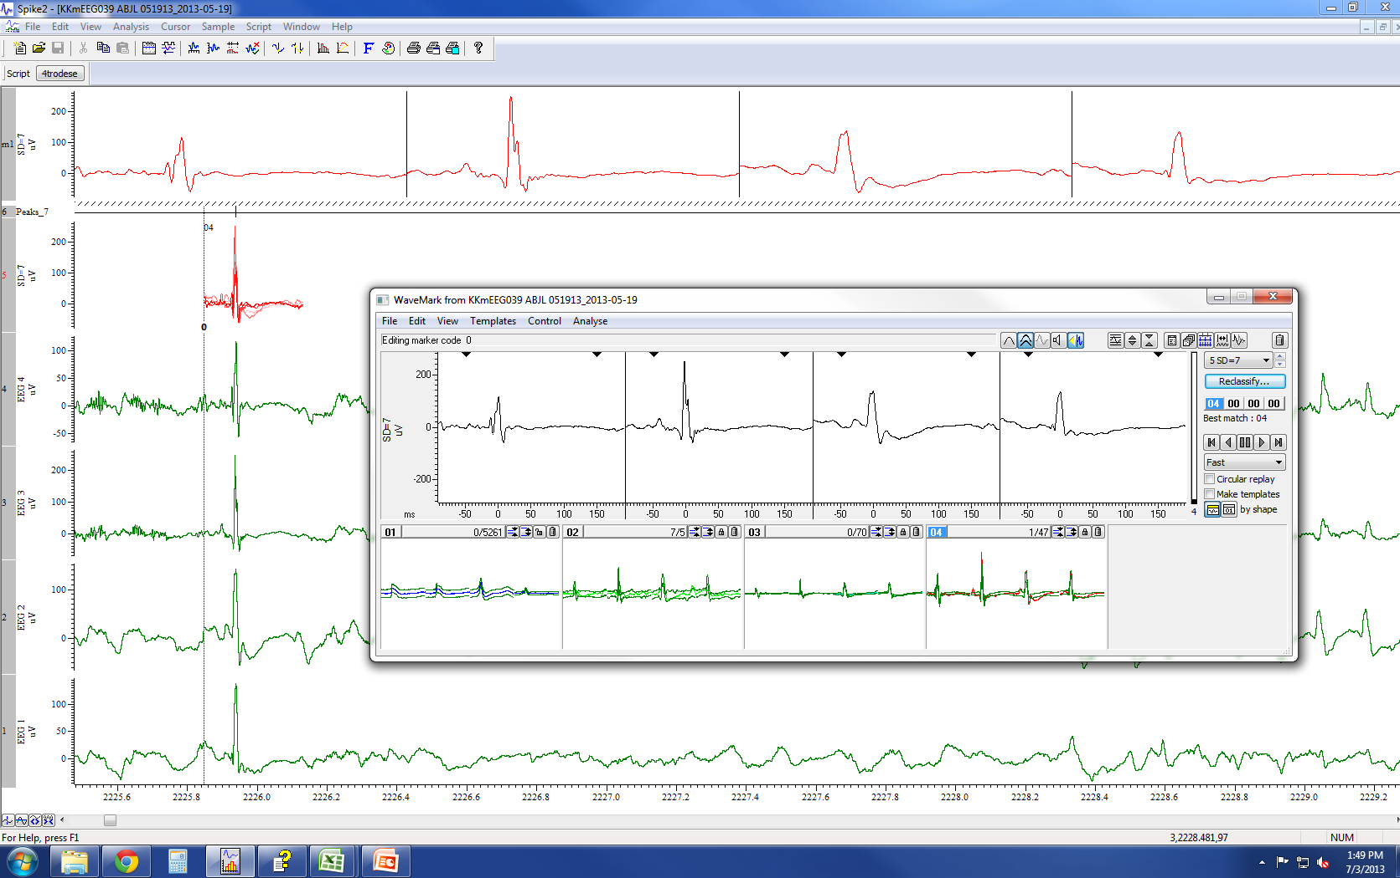
Make templates:
Ntrode→New Wavemark (semi-supervised)
Set thresholds per channel (run kk_4trodesetthresh script)
Track cursor 0
Jump to start
Set duration to -50 to 150 ms
Enable overdraw and “show template limits”
P to play, V to stop
When template created, drag spikes. Make a template for artifacts as well so that they do not contribute to IIS templates.
Cycle through once, then reintialize counters. Make sure to lock template shapes then “Jump to Start.”
Uncheck box “make templates”. We have already created them.
Count and add as wavemark data channel.
Print waveforms.
Verify counts by marker filter → wavemark drawmode Lines →Sum in XY measurements

Slide 27
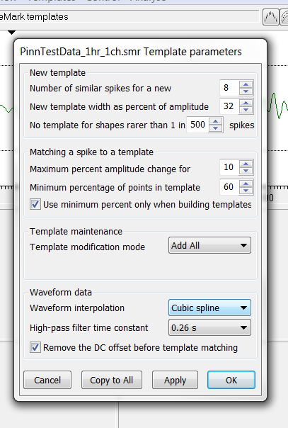
Set template parameters

Slide 28
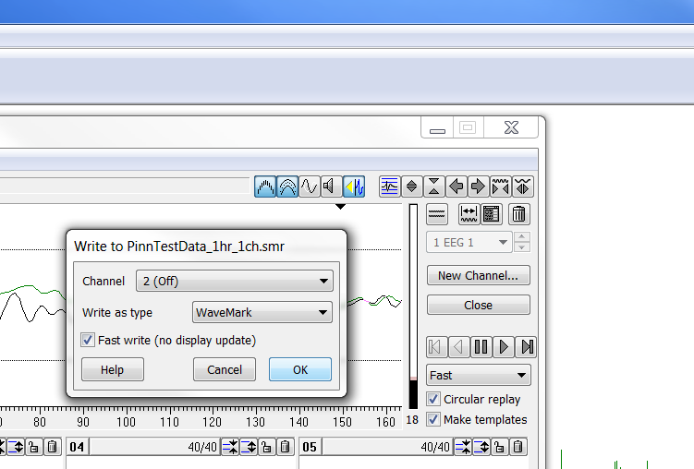
Save templates as a channel

Slide 29
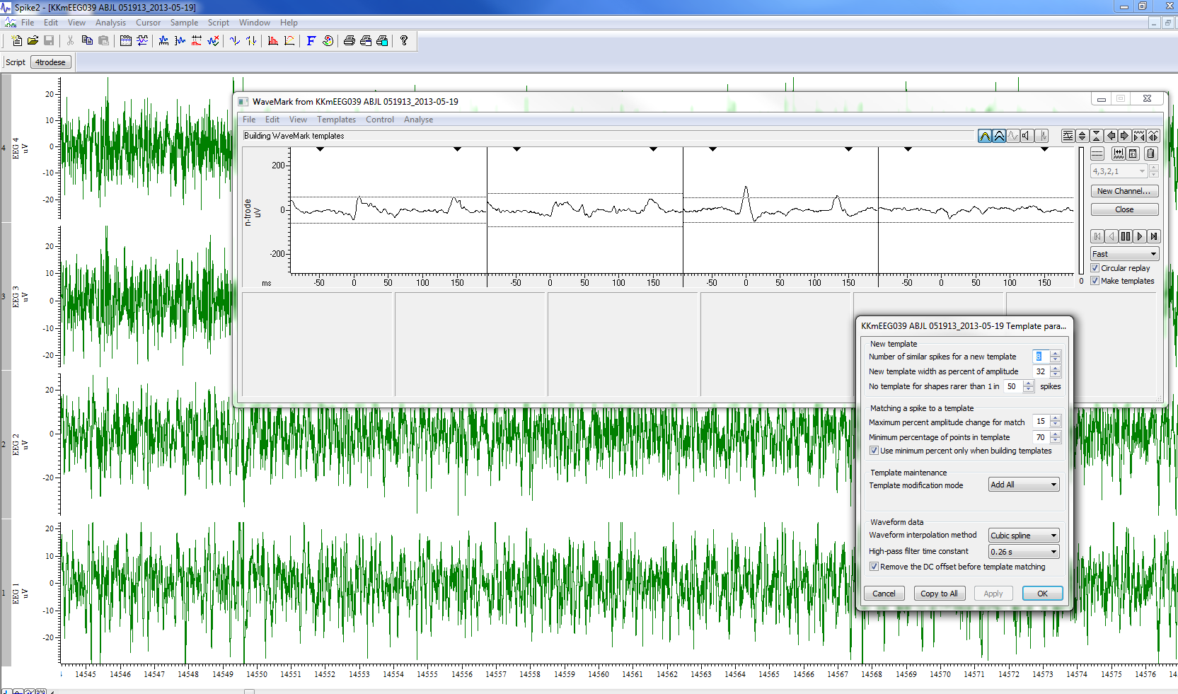
If no templates, make parameters more stringent
If no spikes, either supervised template forming or change Number of similar spikes from 8 to 4

Slide 30
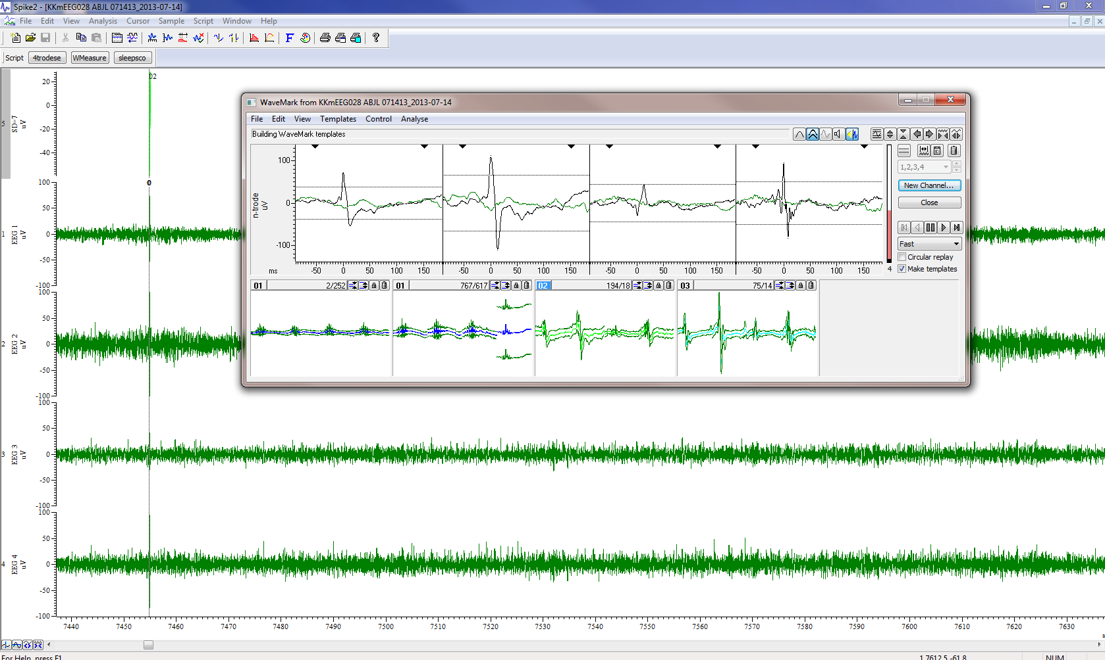
Construct Templates
Run for 1-4 hrs to allow event templates to be made for rare spike waveforms
Notes:
Script:
Calculation of mean but a high-pass filter set for the waveforms passed into the spike shape dialogs, so the waveform has a mean level of 0 as seen by the dialog.
SD: use levels as variable to set thresholds to.
Scale: If any of your channels had a negative scale factor, then you would be setting the trigger levels in the wrong direction. If you do this, then the dialog sets the level to 0.
SSRun() optional: If you want the dialog to run through your data before moving to the next channel you need to set non circular replay mode and then position the replay to the start, use SSRun() then wait for the cursor position to reach the end in a loop that allows the system to idle (i.e. Interact, Toolbar, use a dialog or use Yield().

Slide 31
Event templates

Slide 32
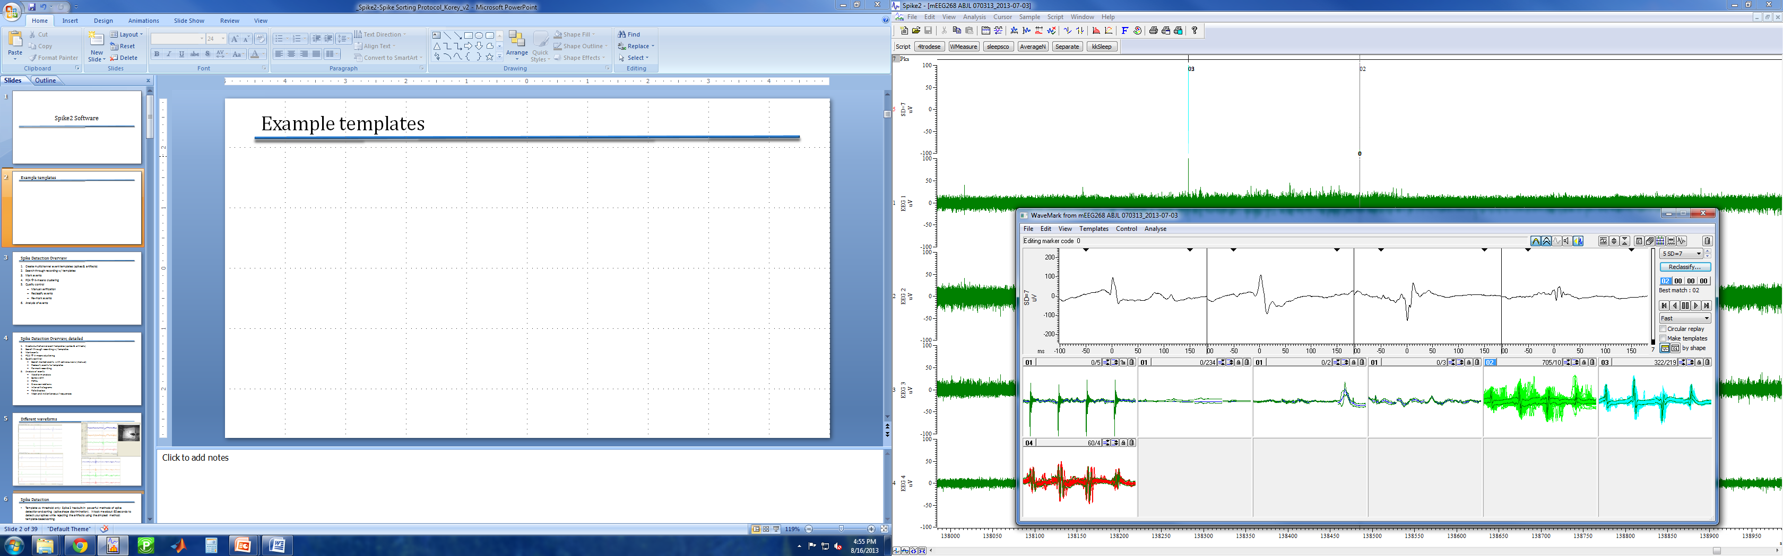
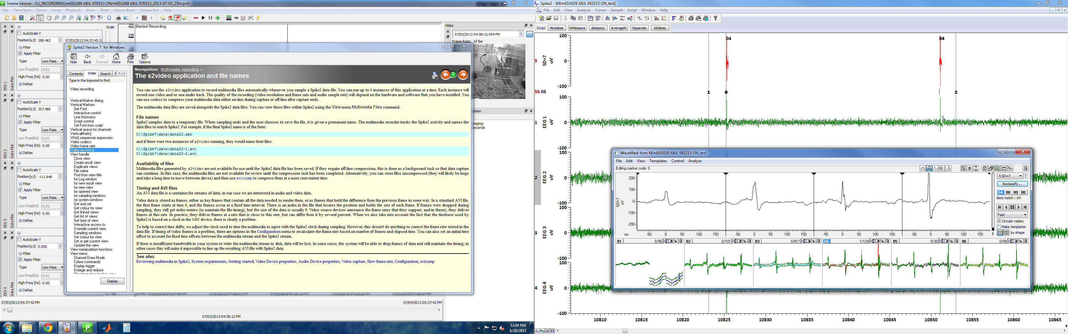
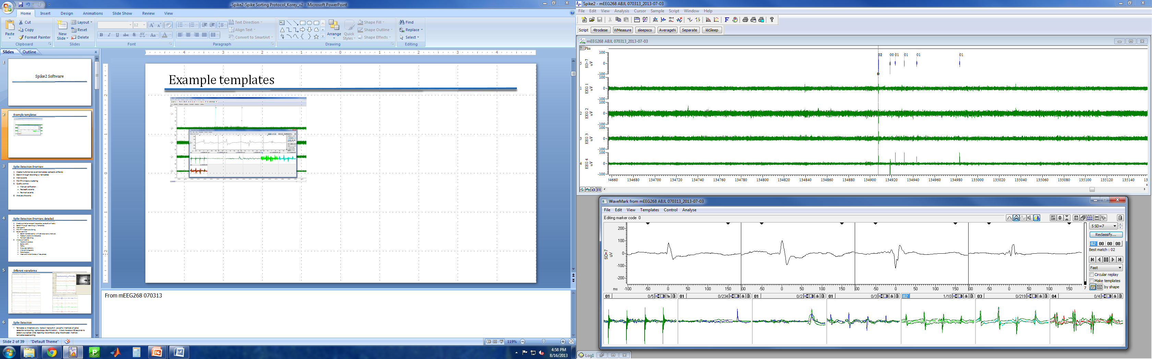
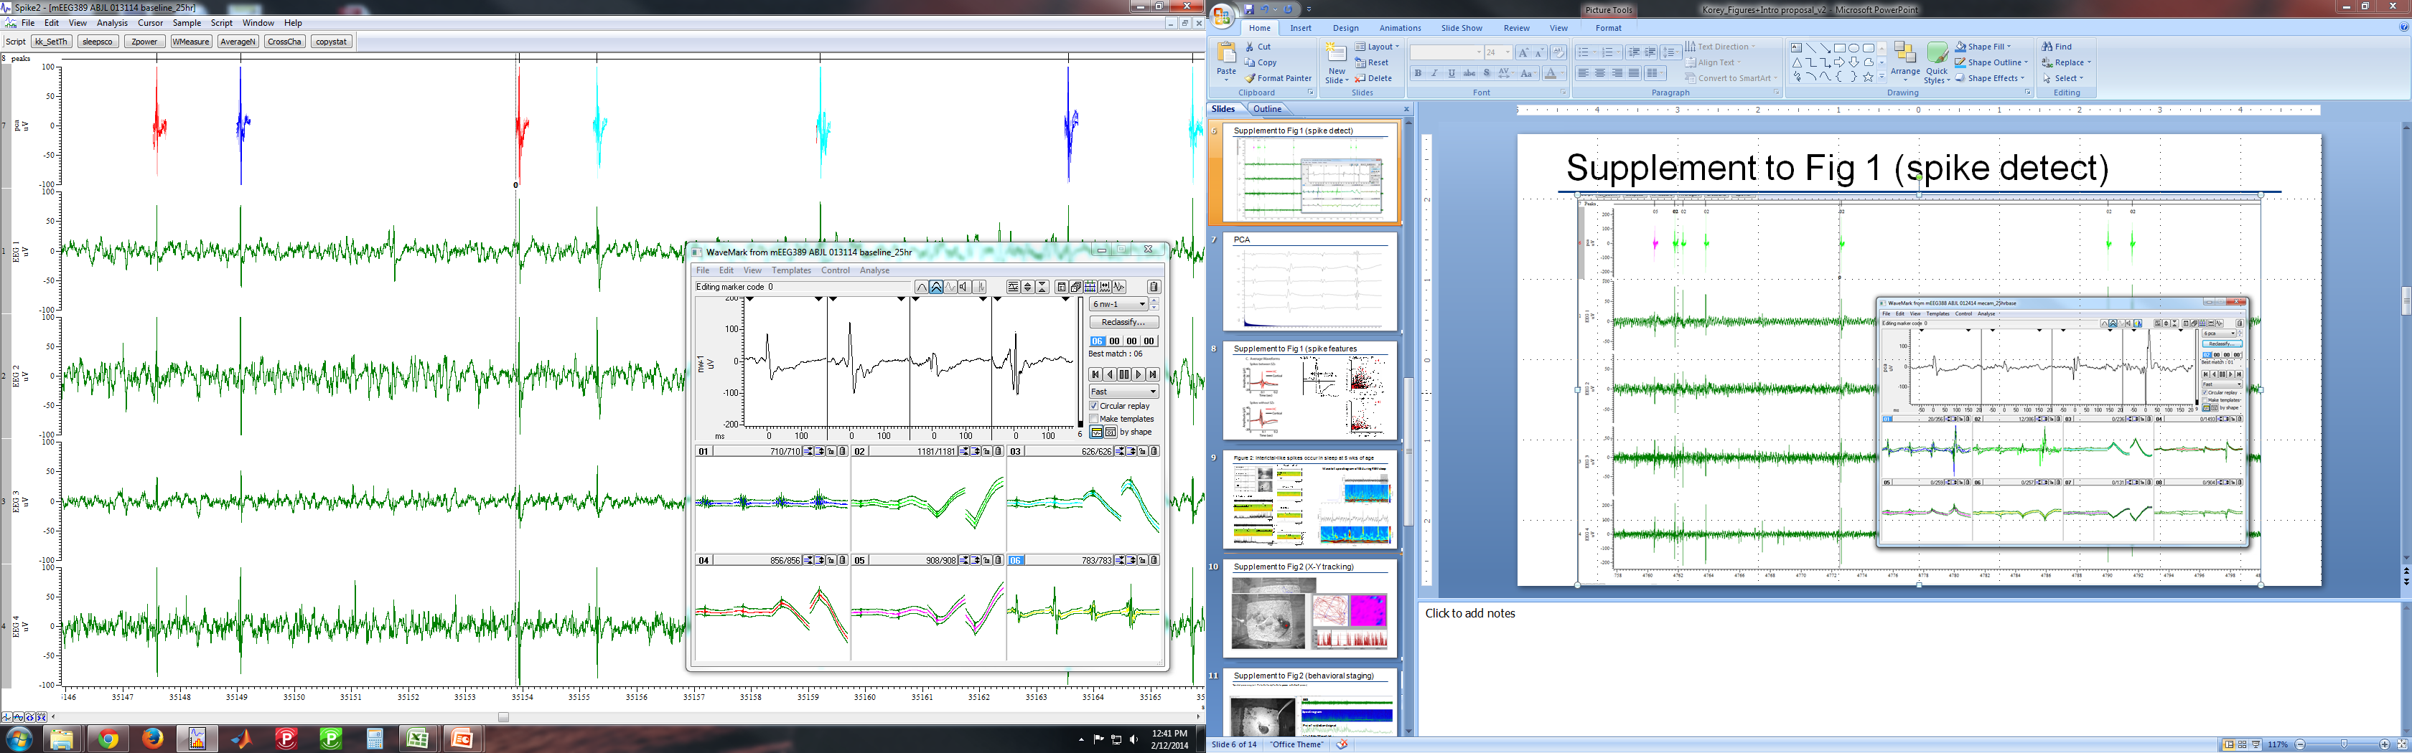
Example templates
Notes:
From mEEG268 070313

Slide 33
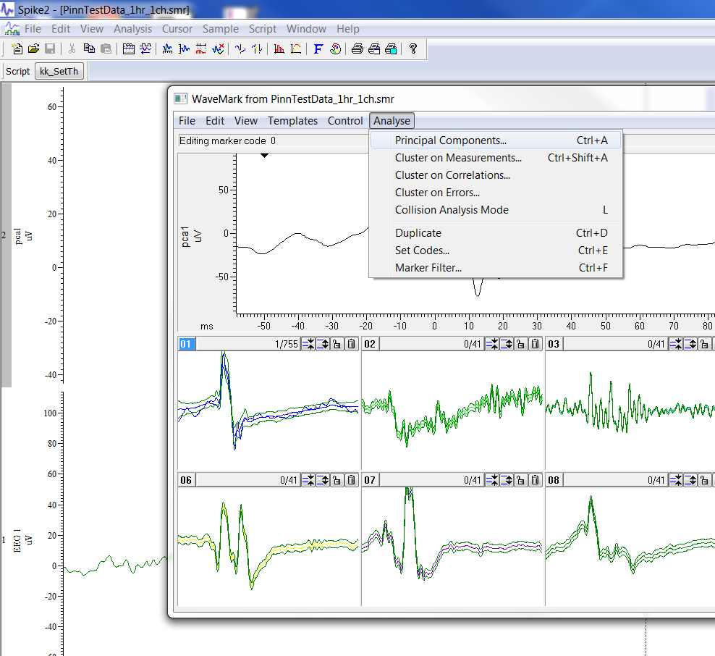
Select PCA

Slide 34
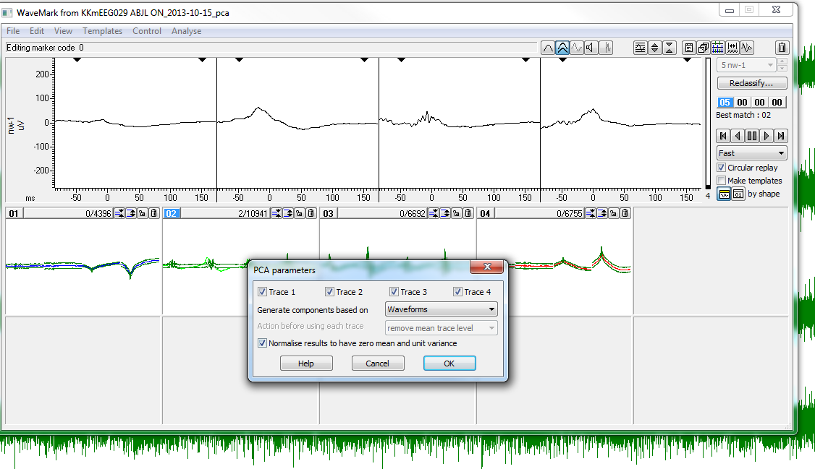
From events to principal components

Slide 35
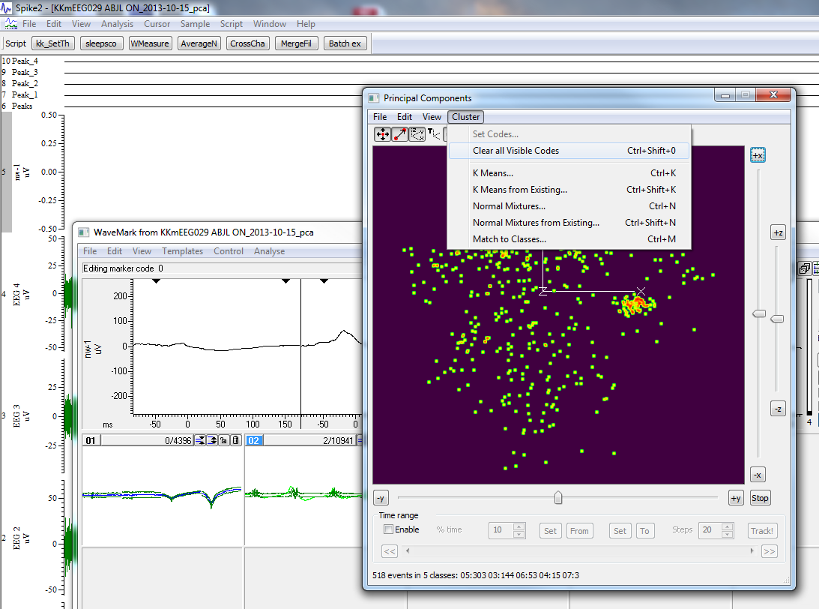
Clear clusters

Slide 36
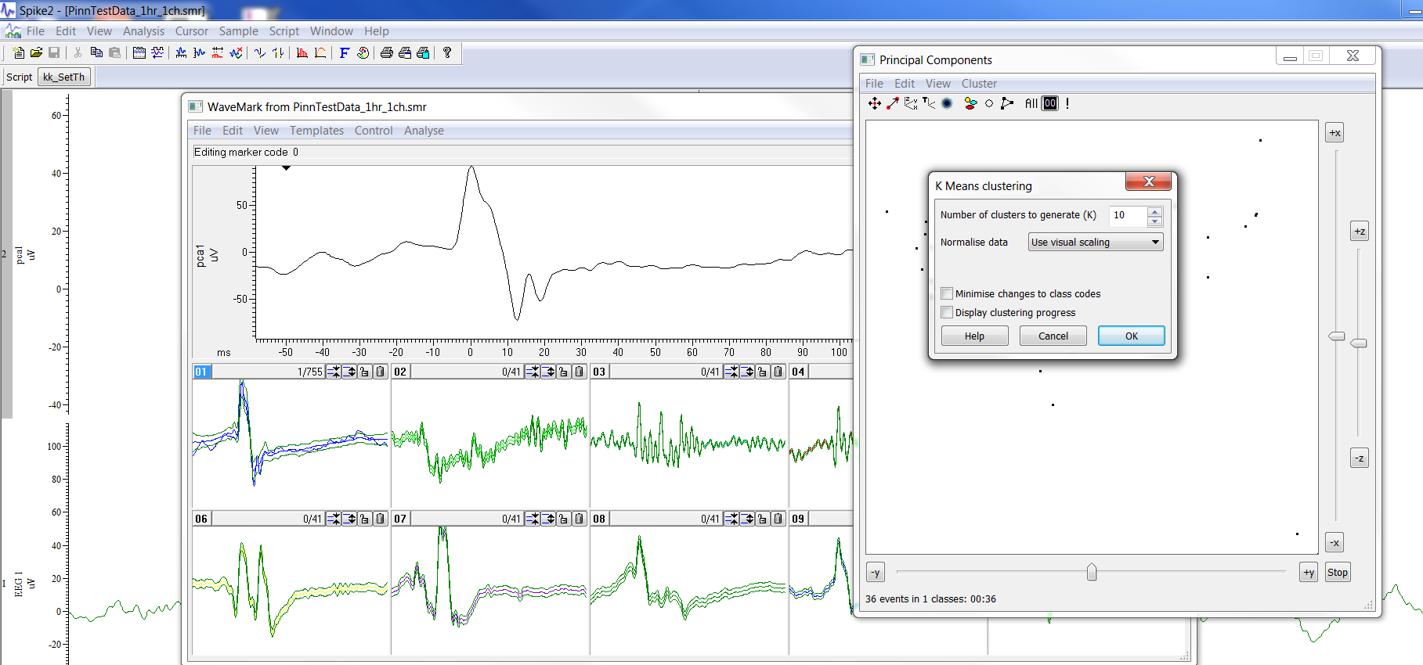
Perform Kmeans clustering

Slide 37
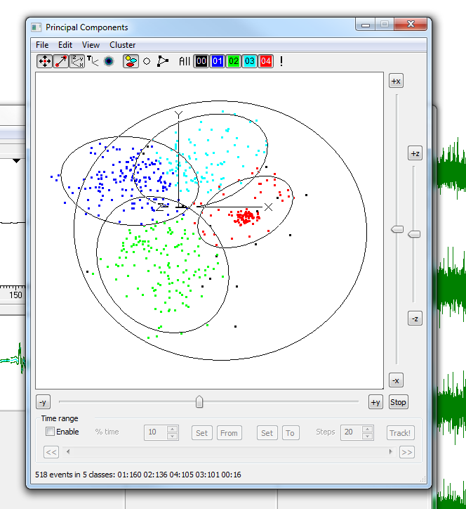
Cluster PCA with Kmeans

Slide 38
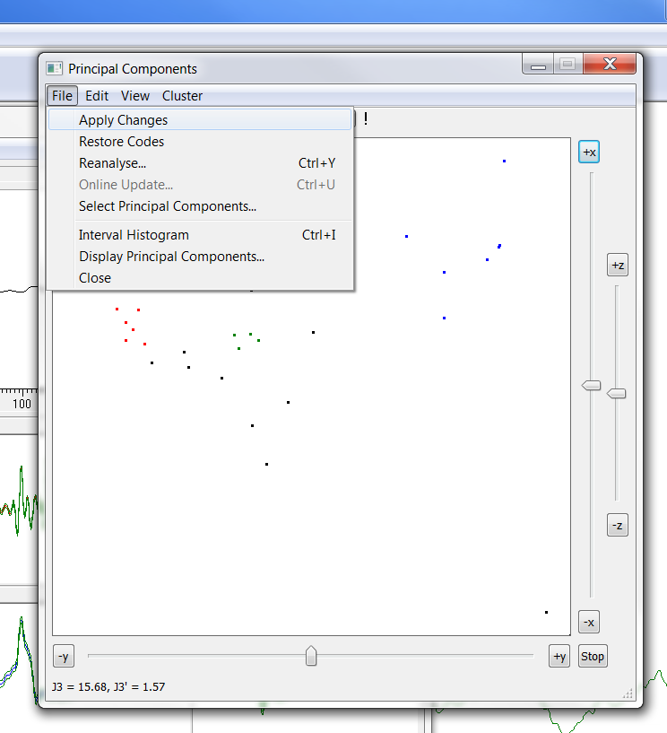
Apply PCA to wavemark channel

Slide 39
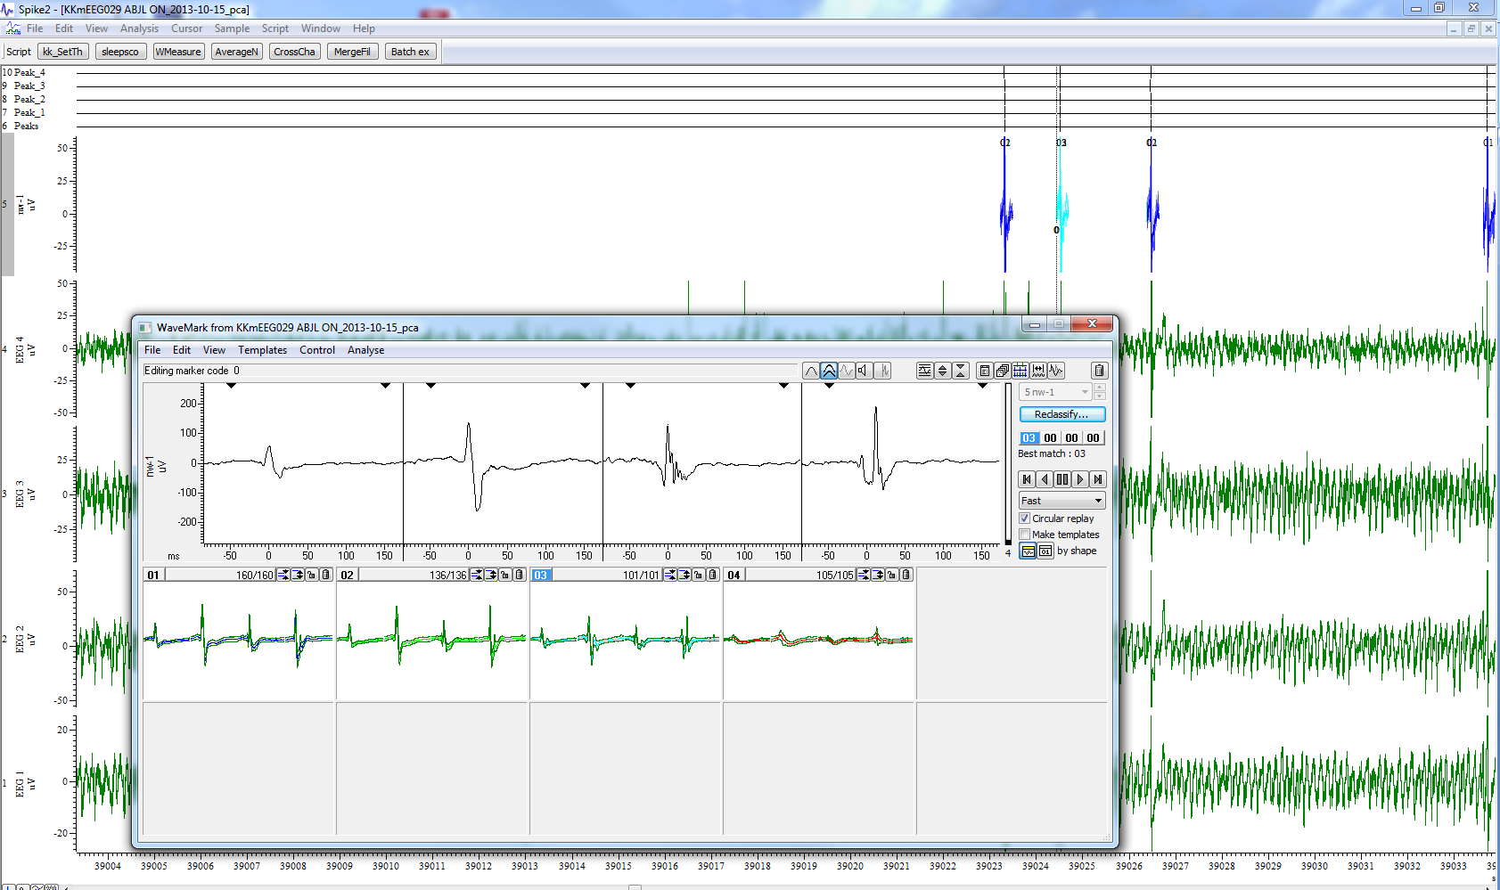
Remove artifacts via PCA & Kmeans
Change marker filter to all codes.
Analyze→PCA
All traces→waveforms→OK
Form cluster centers
Clear all codes
Switch to density
L-click, place user ellipse, Small ellipse
Kmeans from existing, use existing clusters
Apply changes
If satisfied, copy cluster values

Slide 40
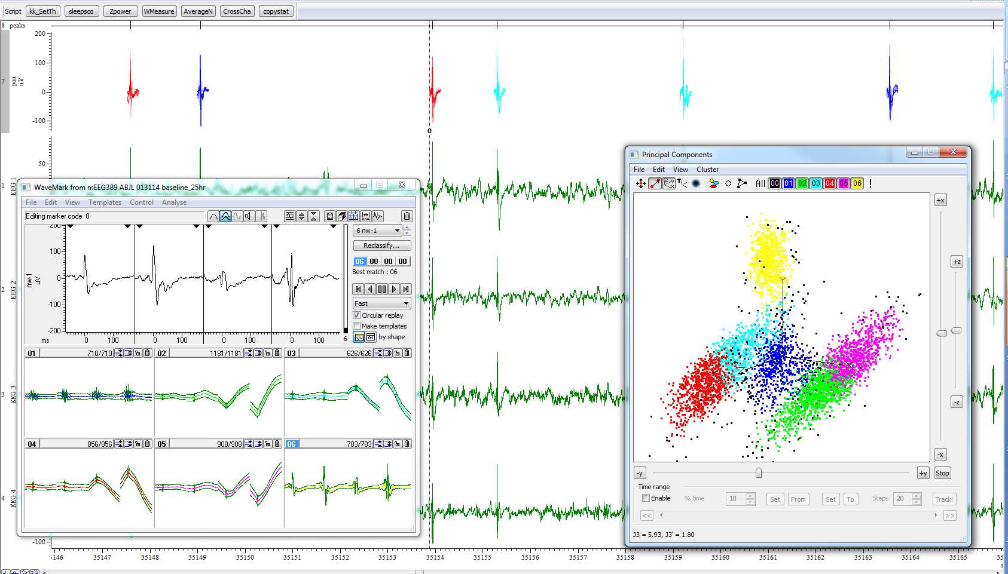
Example PCA templates (spikes and artifacts)

Slide 41
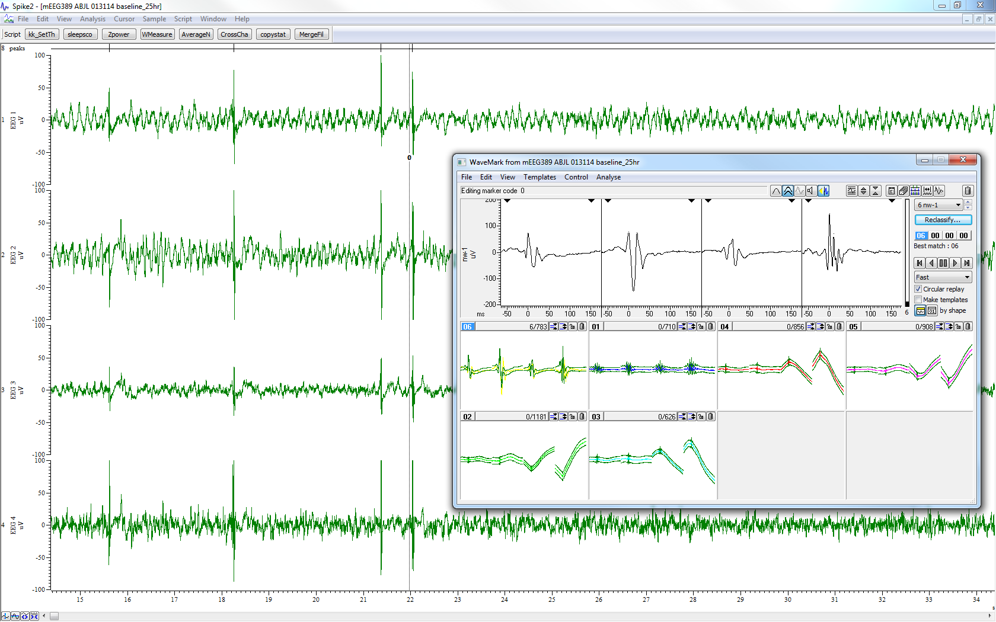
Spike sorting (PCA)

Slide 42
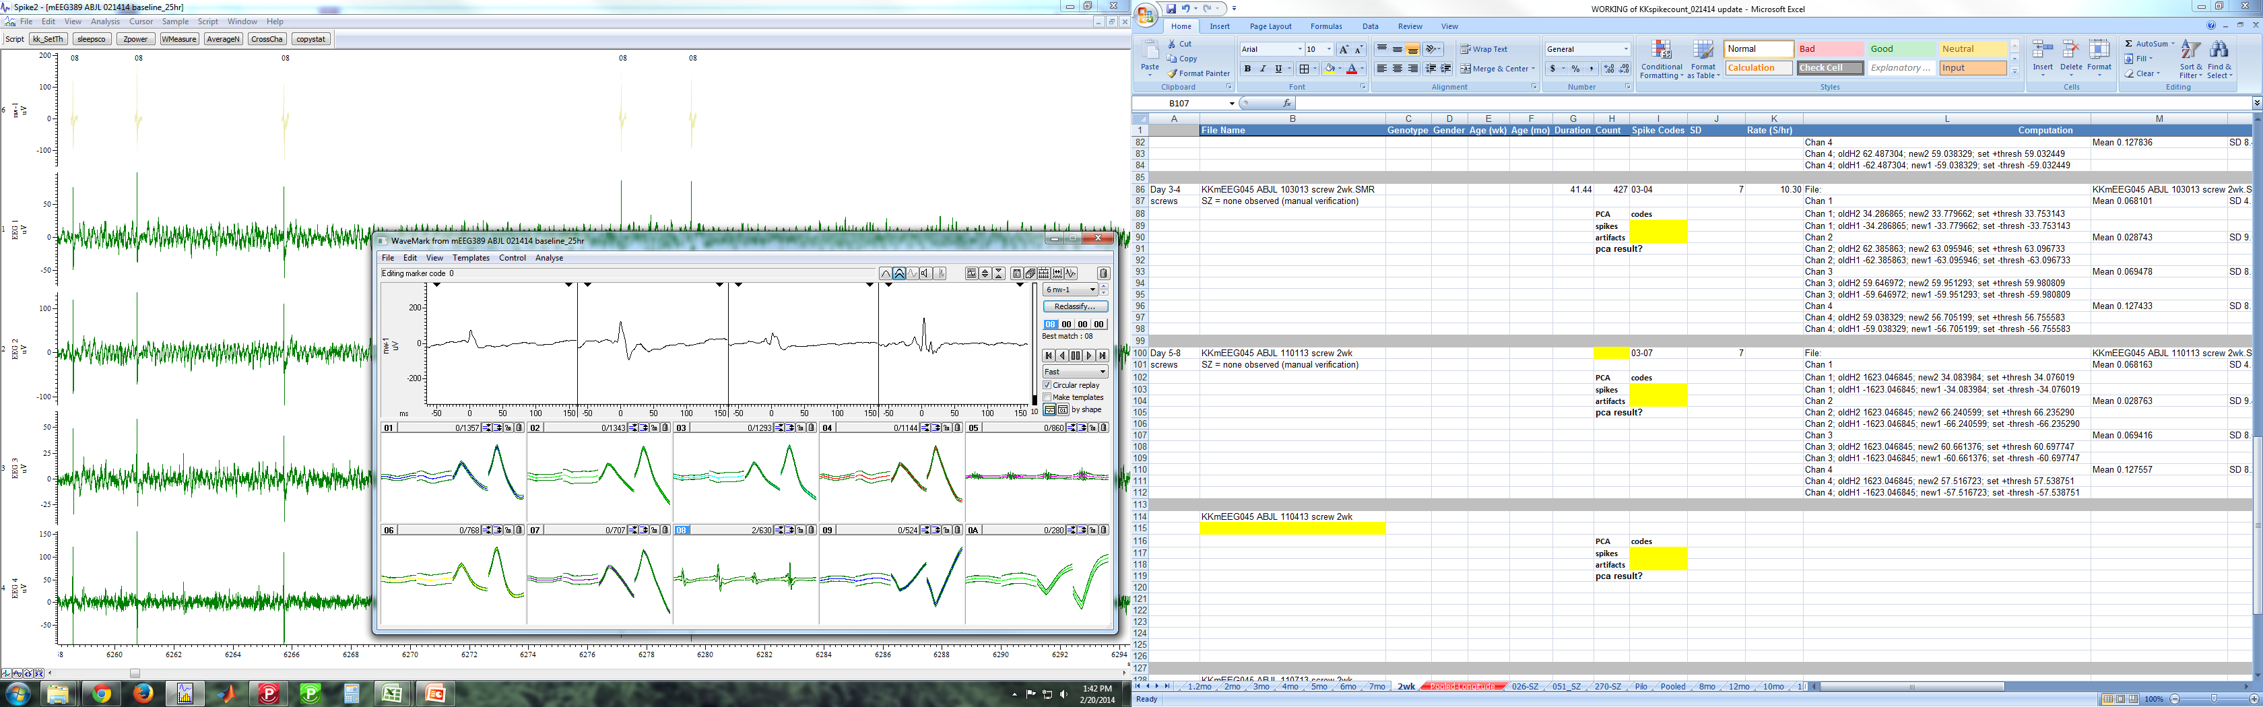
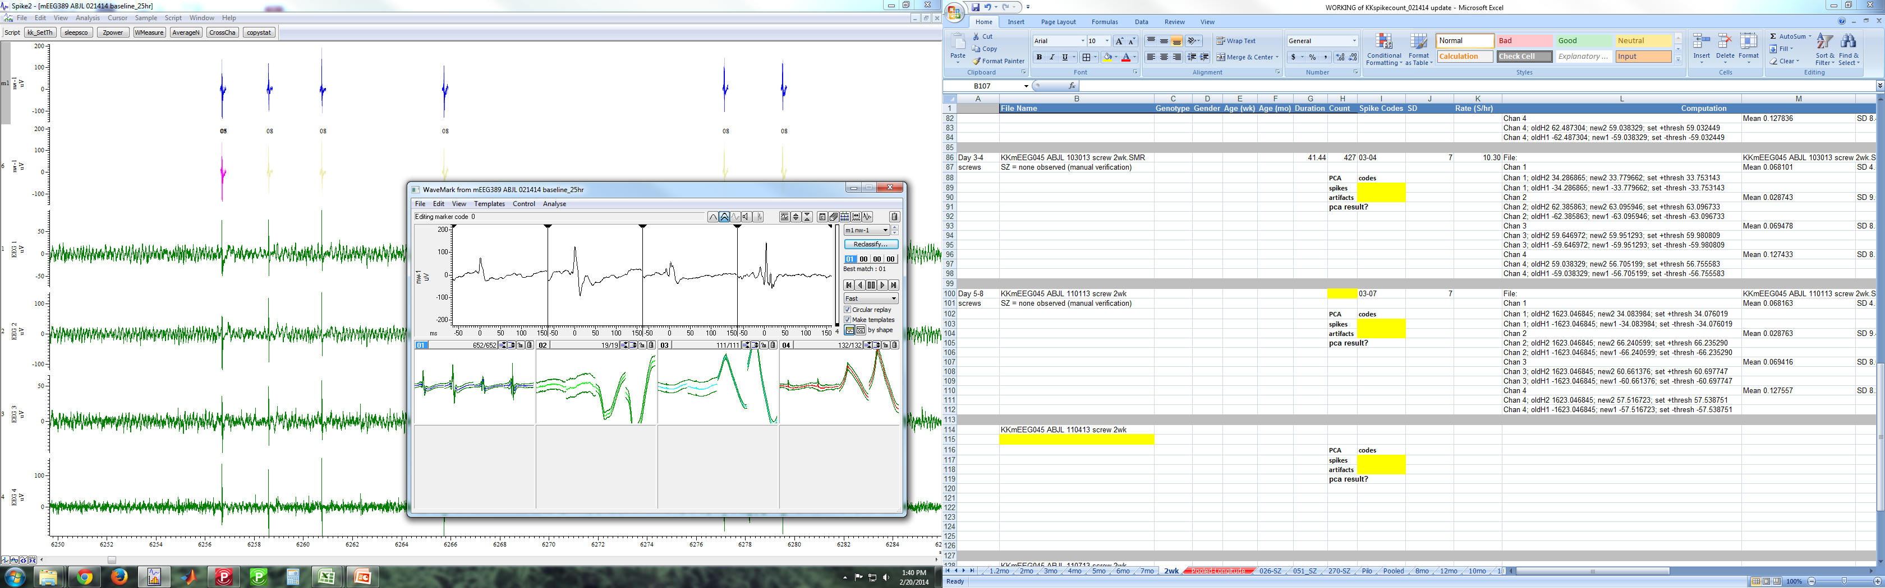
Refinement with PCA

Slide 43
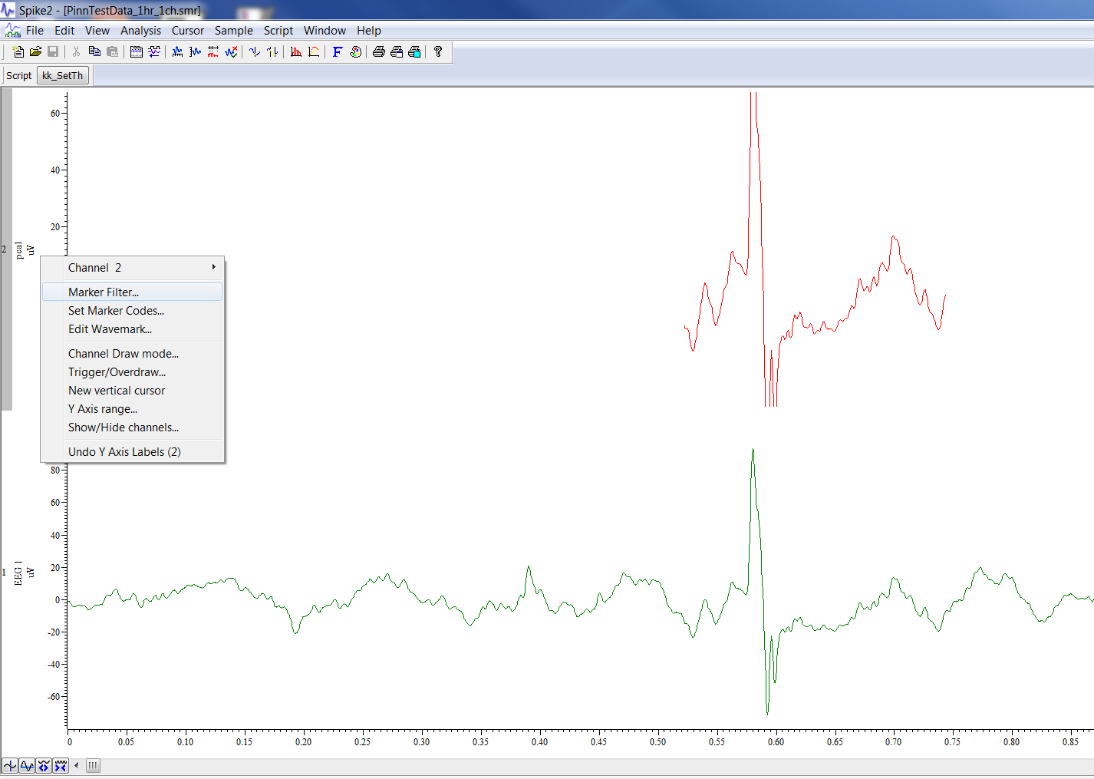
Filter by code

Slide 44
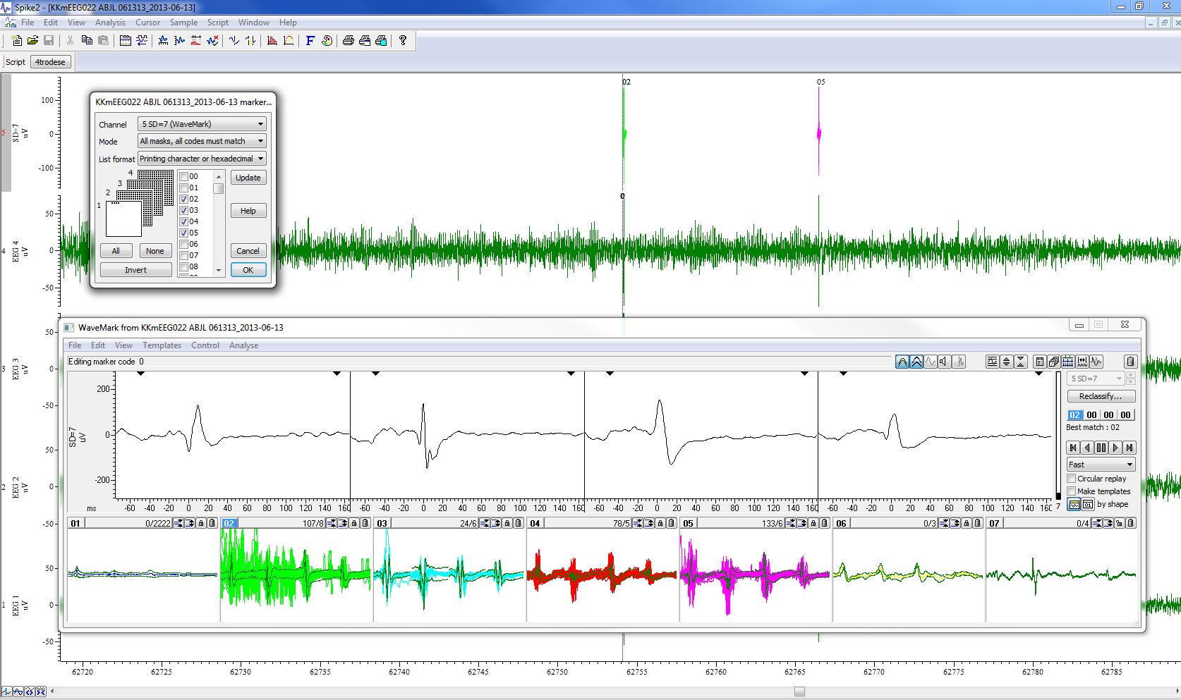
After PCA: filter out artifacts by spike code
Change marker filter to only spike codes.
Reclassify events to spike code.
Verify using Edit Wavemark dialog and Overlay.
Verify using 0 cursor tracking.

Slide 45
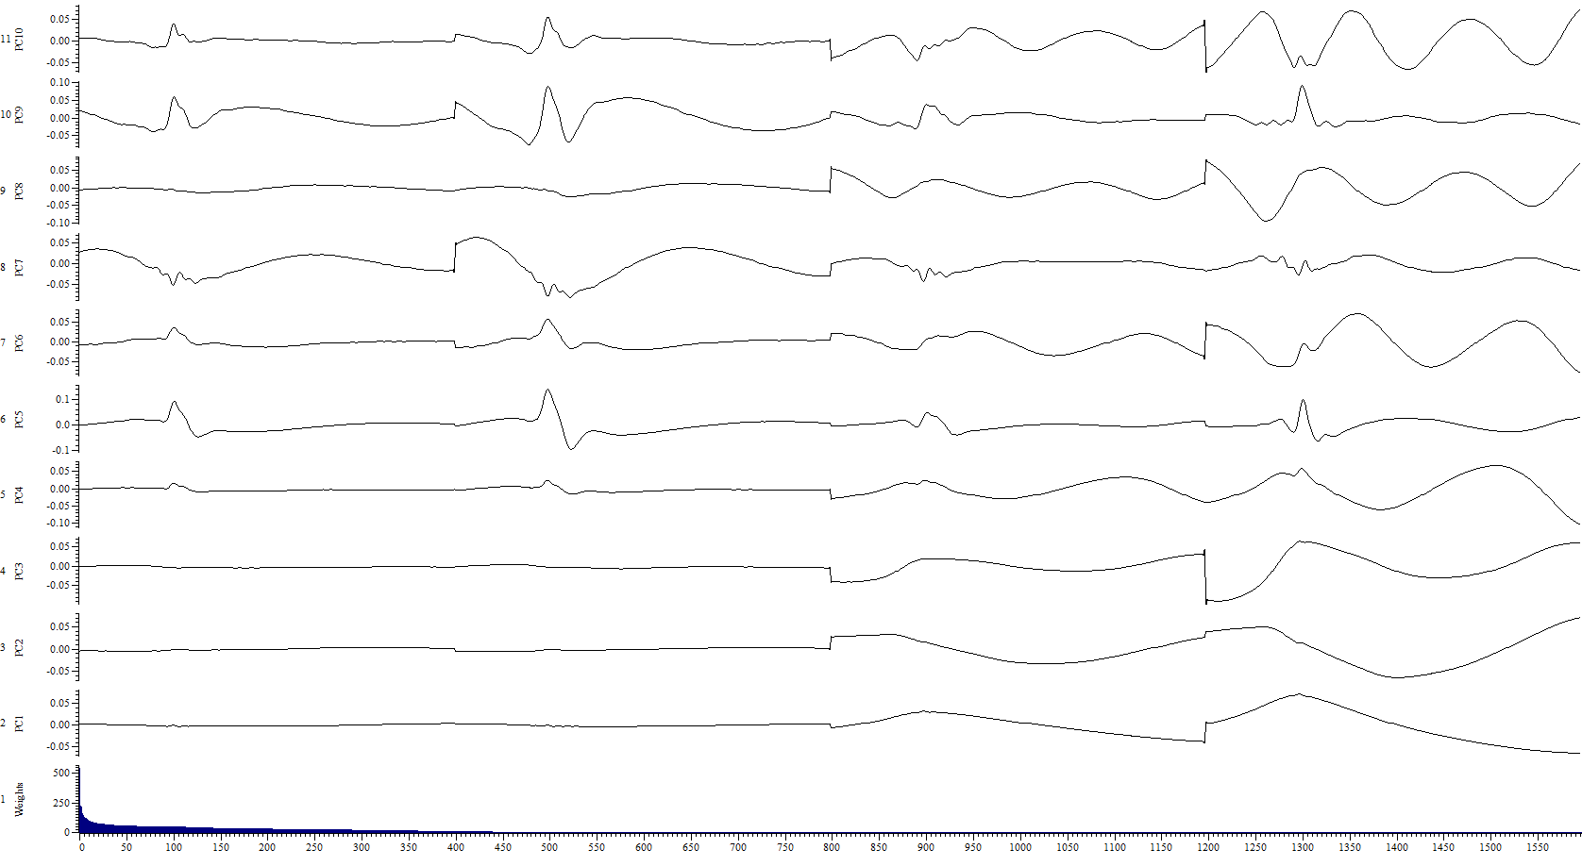
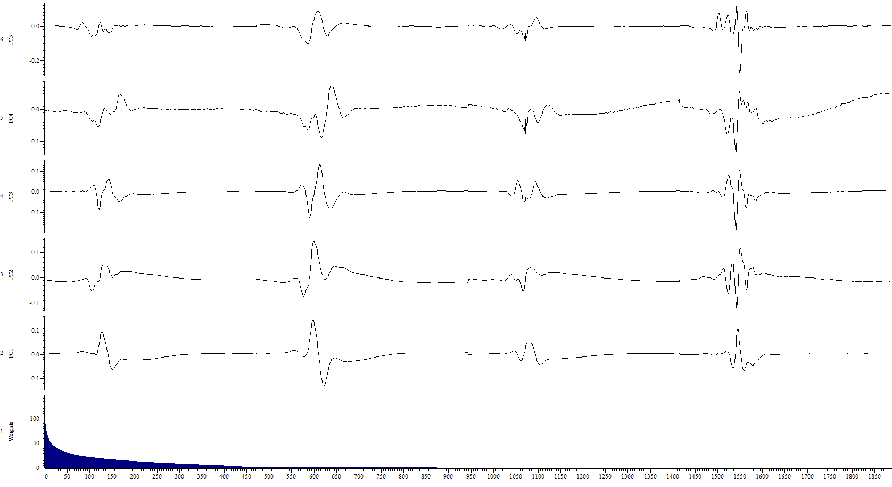
PCA refinement: Results

Slide 46
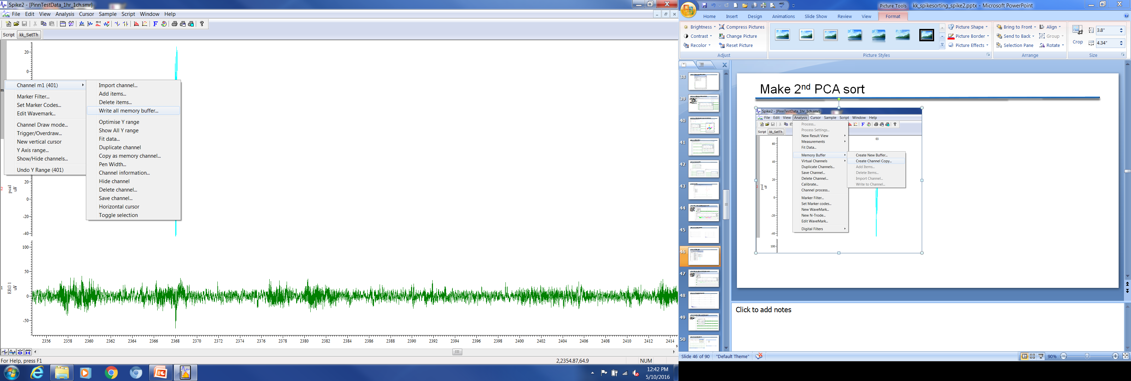
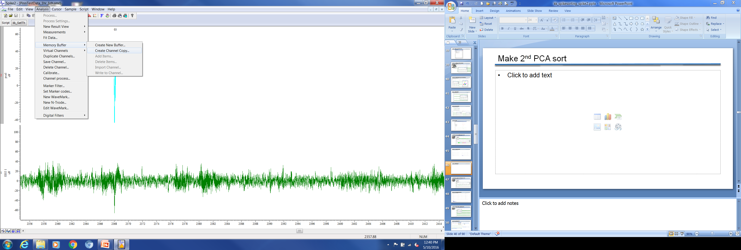
Make 2nd PCA sort

Slide 47
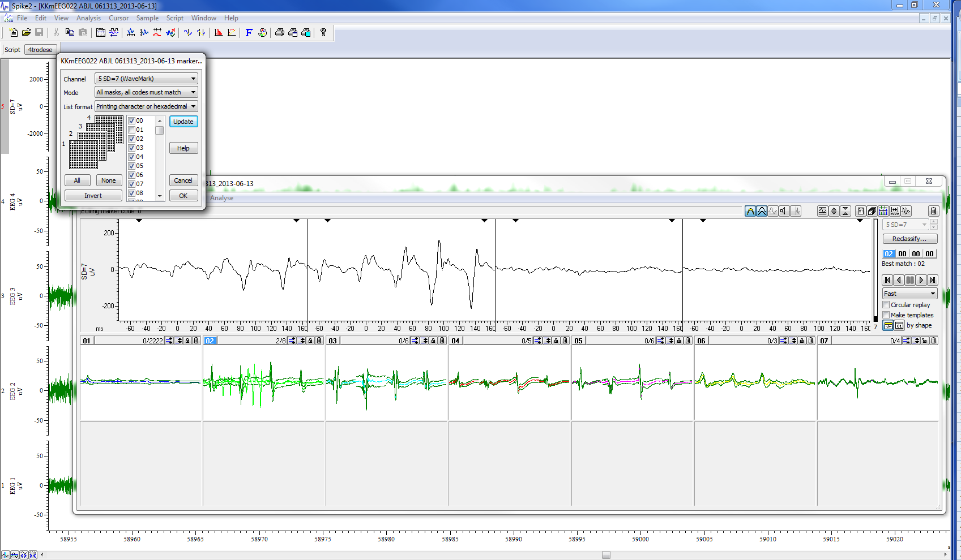
After PCA 2x: refine by filtering spike codes
Change marker filter to all but artifacts.
Reclassify events to spike code.
Any new events that are classified as artifacts can be removed.

Slide 48
Display Principal Components

Slide 49
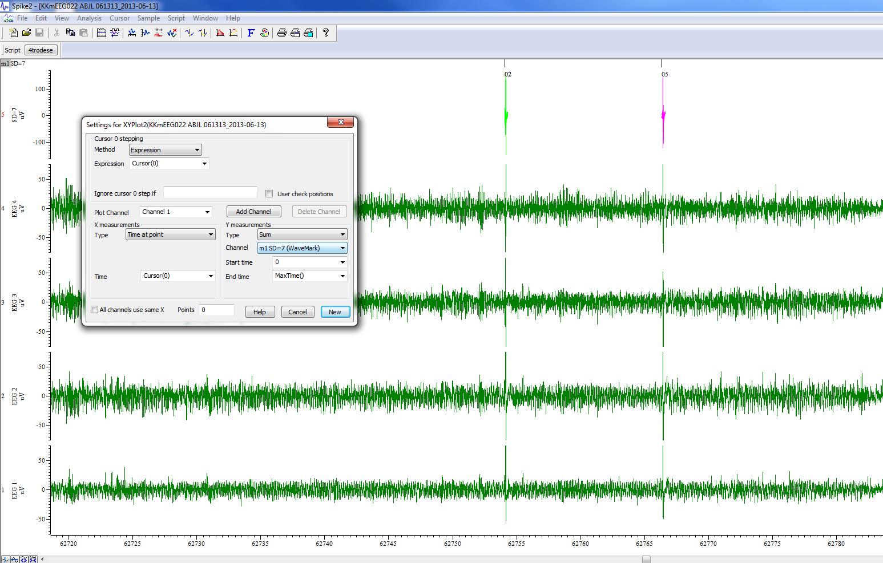
After templates made: count true spikes
Copy as memory channel.
Change channel draw mode to lines.
Count using X-Y method

Slide 50
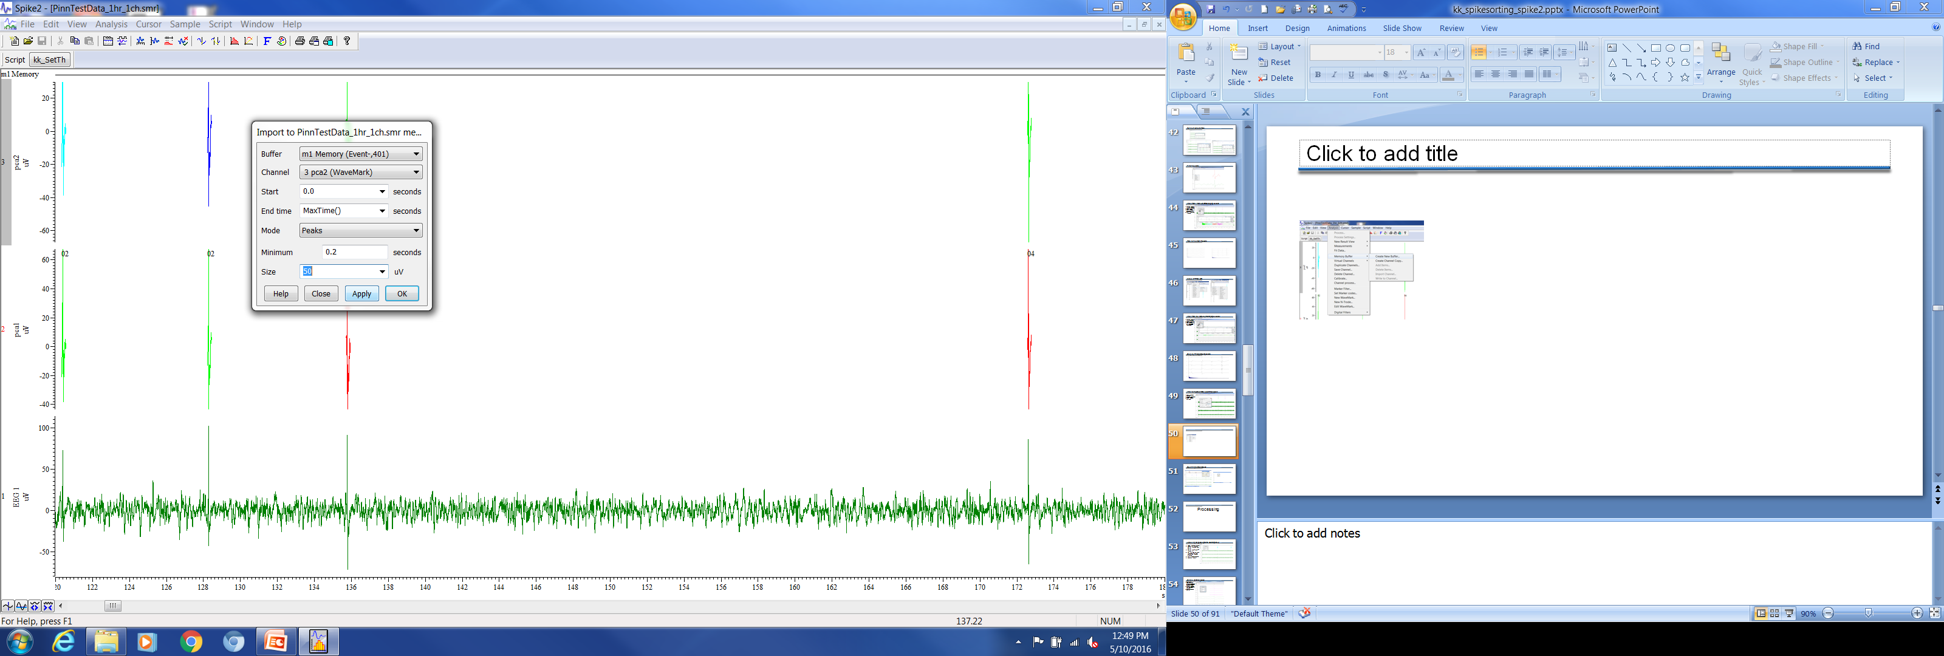
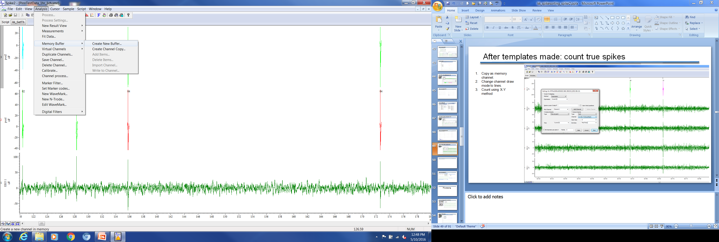
Add tick marks to detected spikes

Slide 51
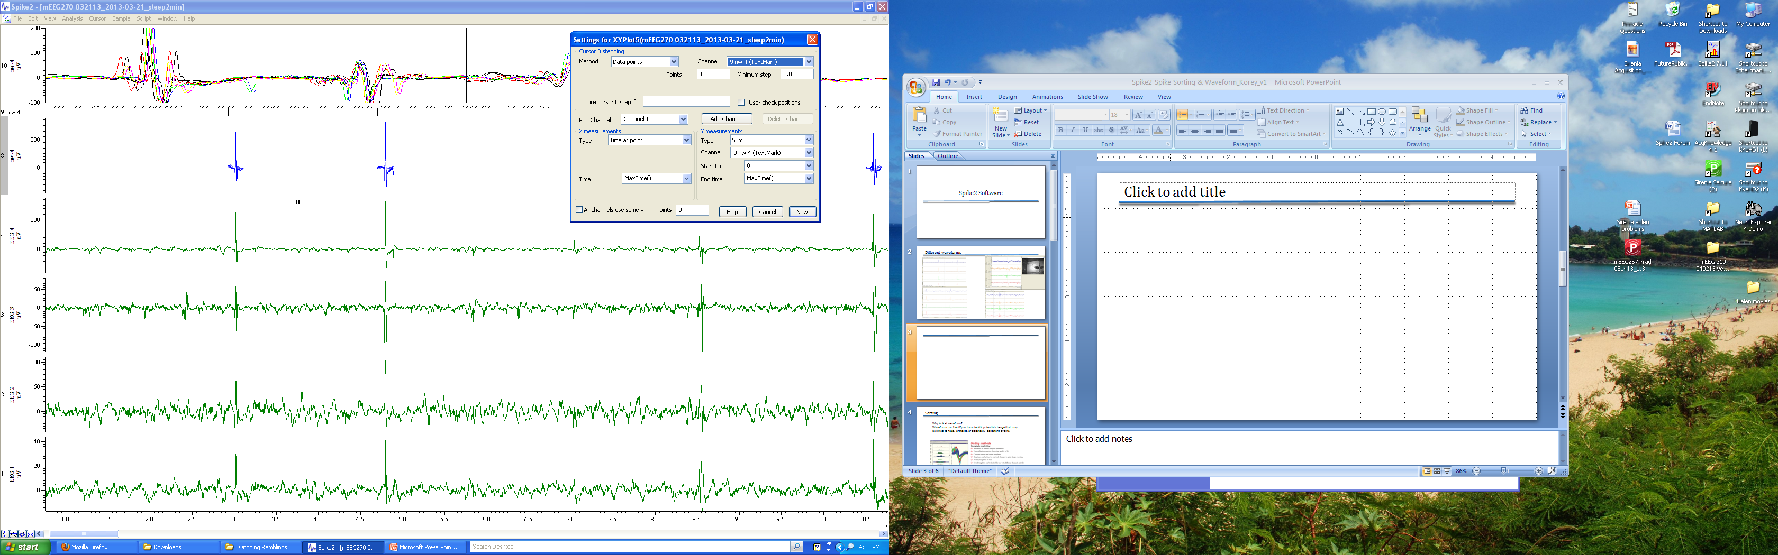
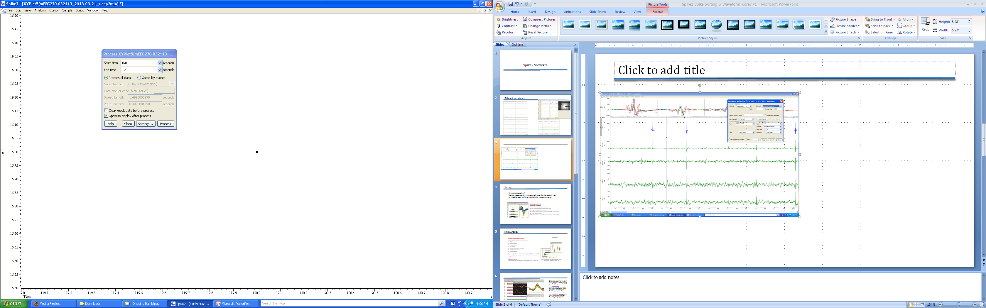
Counting Marked spikes

Slide 52
Processing

Slide 53
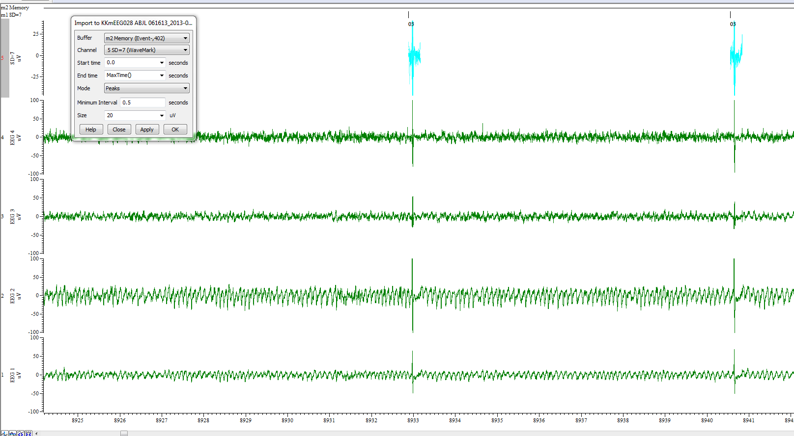
Labeling IIS peaks (prior to counting/ISIH)
Select wavemark channel
Analysis → Memory Buffer → Create New Buffer
Buffer Type “Event-” → Import…
Min Interval = 0.5, Size = threshold ~40 uV or computed threshold crossing
Write All Memory Channel
Rename “Peaks”

Slide 54
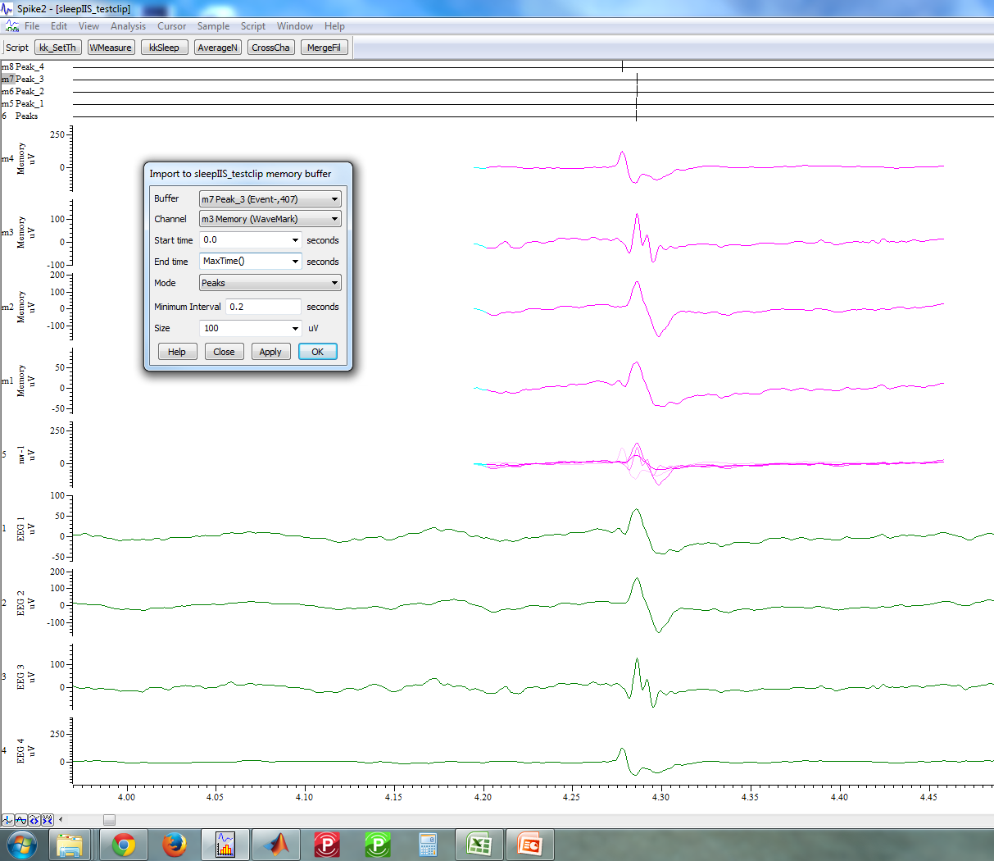
Single channel peaks
Compute AverageNtrode waveforms (separates 4 channel spikes to individual spikes)
Create New Buffer channel (peaks find) for each spike channel
Write all to memory buffer

Slide 55

Searching marked events
Use active cursor search mode
Right: control+shift+→
Left: control+shift+←

Slide 56


Iterations
Repeat PCA-kmeans clustering until all clusters are true spikes (2-3 iterations)

Slide 57
EXPORT to mat

Slide 58


For spike timestamps, do not bin

Slide 59

For EEG data

Slide 60
DRUG studies

Slide 61

Drug studies: set injection times
Set cursor X to time of injection
Create new buffer channel
Buffer type = TextMark, 32 char. Hit OK
Right click on channel, Add Items
Select Buffer channel, Select Cursor (0).
Type description in TxtMark string(drug IP). Hit Add.
Add other textmark items if necessary.
When done, write all memory buffer of the memory channel (Ch TYPE = TextMark).
Go to View, Vertical Marker. Adjust settings.

Slide 62

Drug studies: histogram of IIS
Use WaveMark Measure script.
Source to count: IIS event channel
Measurement: Sum
Start time: Cursor 1 (inject, baseline)
End time: X hours post drug
Plot results

Slide 63
Change in spike shape post-drug treatment
PCA
Time axis view to show drift?
Another advantage of the PCA clustering is that it gives you tools to handle drifting spikes. One tool is to use time as Z axis (keyboard shortcut T, or use the button
on the toolbar). Then press X to ensure that the image is properly oriented, and you will have time running from left to right in the window
There is yet another method of handling drifting spikes in the PCA clustering window.
With Time as Z enabled, press Z. Now you are looking along the Z axis, which is time axis. Enable time range (View>Show time range) and you will see only spikes
within certain percentage of your time range (you can set the percentage). By moving the slider you can observe how your cluster (or clusters) of drifting spikes crawl to
different locations in the PCA space. Use the >> and << buttons to animate it and follow the movement of the cluster. Once you know where it is and where it has
moved, you can move in time stepwise with the slider and use the ellipse or user-defined shape to encircle the cluster of real spikes at each time period and apply a code.

Slide 64

TIFFs of drug effect
Set 0 cursor to hit on injection times in Textmark channel

Slide 65


Light vs Dark Count
Find Seconds @ 19:00:00 = 7:00 PM
Find seconds @ 1:7:00:00 AM
12 hrs = 43200 seconds

Slide 66
OLD STUFF

Slide 67

Example results

Slide 68


Marking IIS

Slide 69

Identify IIS (cross channel events)
Select wavemark channel
Analysis → Memory Buffer → Create New Buffer
Buffer Type “Event-” → Import…
Min Interval = 0.2 sec, Level = threshold 49 uV
Write All Memory Channel
Rename “IIS”

Slide 70

Separate Ntrode traces
Get channel info. Points=532, Pretrig=171, Traces=4

Slide 71


Event correlation
FC-RHC
FC-OC

Slide 72
PERFORMANCE

Slide 73


Automated detection of interictal spikes w/ artifact rejection
RHC
LHC
FC
EC
How?
With waveform shapes based on templates and amplitude thresholds

Slide 74
Spike Detection Performance
Validated on long recording (19.4hrs) of 5.6 wk old Tg2576 male

Slide 75
Diurnal Cycle of Spikes
Validated on ON recording (19.4hrs) of 5.6 wk old Tg2576 male

Slide 76

Waveforms
Movement-related Artifacts
Interictal Spikes
Overlay
EC
FC
LHC
RHC
Validated on ON recording (19.4hrs) of 5.6 wk old Tg2576 male

Slide 77




Average waveform
Waveform Ave (black)+ SD (red)
Filters: none
Time: 0 to Max
0.25s bins
Trigger on self
Notes:
Yes, you can do it, but after you apply your clustering to the data file. In the time view which holds your spike channel, use Marker Filter to select your first spike. Then go to Analysis > New result view > Waveform average and set: Channels AND Trigger to your spike channel, Width to the length of a single spike trace in seconds (I'll get back to it), Offset to 0, Align data to "Next data point", Display mean of data and Error bars to enabled. "Keep item count" does not matter in this case. Press New. In the next dialog (Process dialog), select the time range of in your file over which you want to average the spikes; normally it would be 0 to the end of file. For the end of file use MaxTime(), but the dialog should default to the entire file (expressed as the number of seconds) anyway. Use Process all data and Optimise display. Clear result may be needed if you re-do the analysis in the same window. Press Process. You should get your mean waveform, but with SEM instead of SD. Right-click on it, select Channel draw mode and change error to SD. If you want a smoother-looking trace, change the drawing mode from Lines to Cubic Spline. You may need to optimise the Y axis to accomodate the SD lines. Press Ctrl+Q or right-click on the Y axis and go to Y axis range > Optimise. I think this is the closest you can get in Spike2, with the +/-SD range shown as two lines instead of colored area. Now go back to your time view, use the Marker Filter to select another spike, and repeat the process. And here is how to figure out the length of a single spike trace. One method is to zoom in on a single spike, and use two cursors and Cursor Regions windows to measure it manually. Another one is to click on the data file (to ensure it is the current view), then go to Script>Evaluate, enter BinSize(1)*MarkInfo(1) (instead of the 1s, use the channel number of your spike channel) and click on Eval(...).

Slide 78

Detect Peaks
Detect peaks of wavemark data. (Create New Buffer Channel)
Buffer Type = Event-
Mode = Peaks
Min interval = 0.5 sec
Size = 5 uV

Slide 79

Inter-Spike Interval Histogram
From peak located event channel.
Analysis→New Result View→Interval Histogram
Channel = Peak labeled
Width = 60 sec
Bin size = 1 sec
Min interval = 0

Slide 80


PCA
K means clustering = 3

Slide 81
Spike Width
Roughly speaking you first set up cursor 0 so it iterates from spike to spike, then set up other active cursors that find the relevant locations starting from cursor 0. So you might set cursor 1 to find the spike peak, cursor 2 to find the start of the spike and cursor 3 to find the end. These last two will be the difficult ones - you may have to use two more cursors to find the steepest rising & falling slope, then search out from those positions using slope percentage searches to find when the slope drops to 20% of the maximum. Once the cursors are set up you can create your XY view and generate the measurements to it pretty simply - so the amplitude is level at cursor 1 - level at another cursor using the value difference measurement, duration is a time difference measurement and area is a curve area measurement. You can save your active cursor settings using File : Resource Files : Save resources as and they can then be applied to another file using File : Resource Files : Apply resource file.
http://www.ced.co.uk/phpBB3/viewtopic.php?f=13&t=1204

Slide 82


Spike Width
http://www.ced.co.uk/phpBB3/viewtopic.php?f=13&t=1204

Slide 83

Spike Analysis

Slide 84

Spike detection and sorting Spike2 identifies and sorts single and multi-unit activity both on-line and off-line. It can mark events using simple threshold crossings or sort up to 32 channels on-line with whole wave spike shape template matching.
For multi-unit recordings, Spike2 contains tools for sorting spikes based on the spike waveform shape. All events crossing a threshold are captured. A combination of template matching and cluster cutting based on Principal Component Analysis (PCA) or user-defined measurements is then used to sort spikes into different units
The template matching system allows templates to be fixed or to track changing spike shapes. Templates can be created automatically or by manual selection of individual spikes.
Cluster cutting methods plot measured values into a 3D view that can be rotated and replayed to show the occurrence of the spikes through time. Clusters are formed by automatic algorithms or manually by placing ellipses. Interactive features include INTHs for current cluster classes, tracking over time, and selection of an individual spike by clicking on its dot in the cluster.

Slide 85

EXPORT smr post8hr
Time (s) = cursor + 3600*8
Time shift to 0
Set big file

Slide 86
Stage/Counts
After export, check PCA spikes
Sleepscore to get spectral power
Zscore wideband power
Stage with video/movement

Slide 87

Timestamps from Spike2: make “events” file
Do not align and bin event channels

Slide 88

Separate channels (averageNtrode script)
Select PCA sorted channel
Execute AverageNtrode script
Find peak times in memory buffer, call channel “spikeX”
Write buffer to file

Slide 89

Separate channels: make timestamps (events)
Make Events channel using “Peaks” of wavemark channel with horizontal cursor

Slide 90
Separate spike channels: export to matlab as TIMESTAMPS vector
load('417_7mo_spikeTimes.mat') at roughly 7kb

Slide 91

Separate channels (crosschan script)

